Slide 1
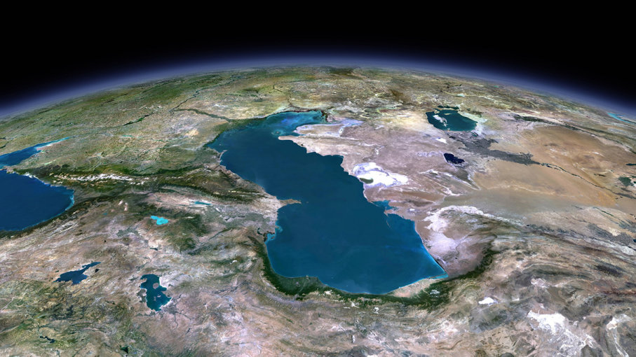
Caspian Region

Slide 2
Key Issues
Economy, Trade and Transit
Energy (Hydrocarbons, Renewables)
Security
Environment
Legal Disputes

Slide 3
Economic Growth and GDP

Slide 4
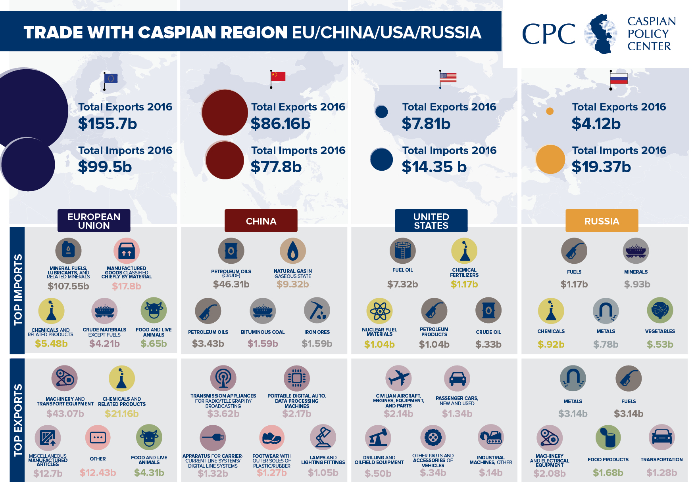
EU, China, US, Russia Trade with Caspian

Slide 5
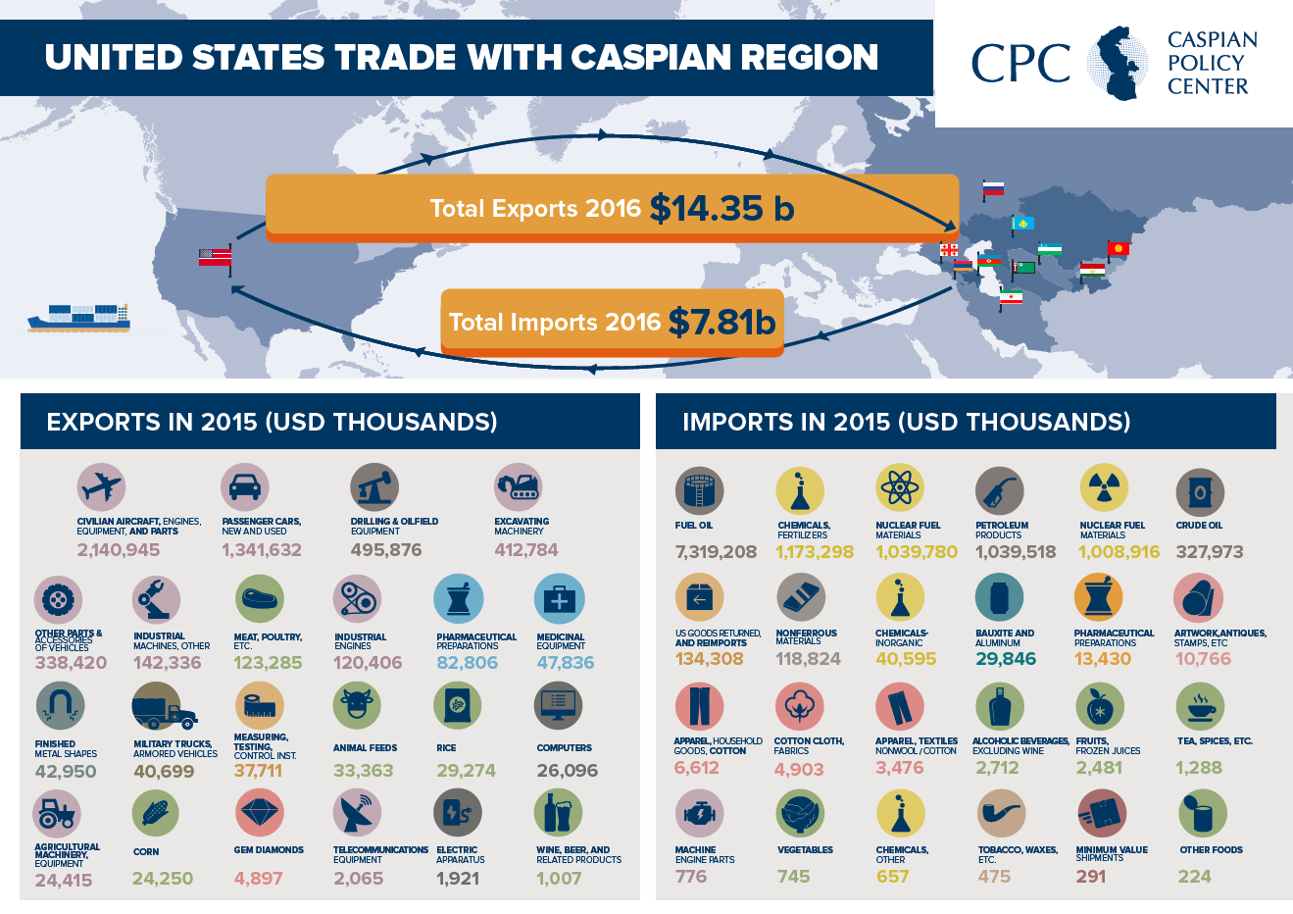

Slide 6
Connecting the Caspian Trio
- Arctic to Gulf (Russia – Caspian – Iran)
- China’s Belt and Road Initiative
- 37 Billion USD invested in 206 projects
- Intra regional connectivity and trade has to improve (only 8 percent now)
- Example: Uzbek – Tajik opening (bilateral trade went from 10 to 110 million in just two years

Slide 7
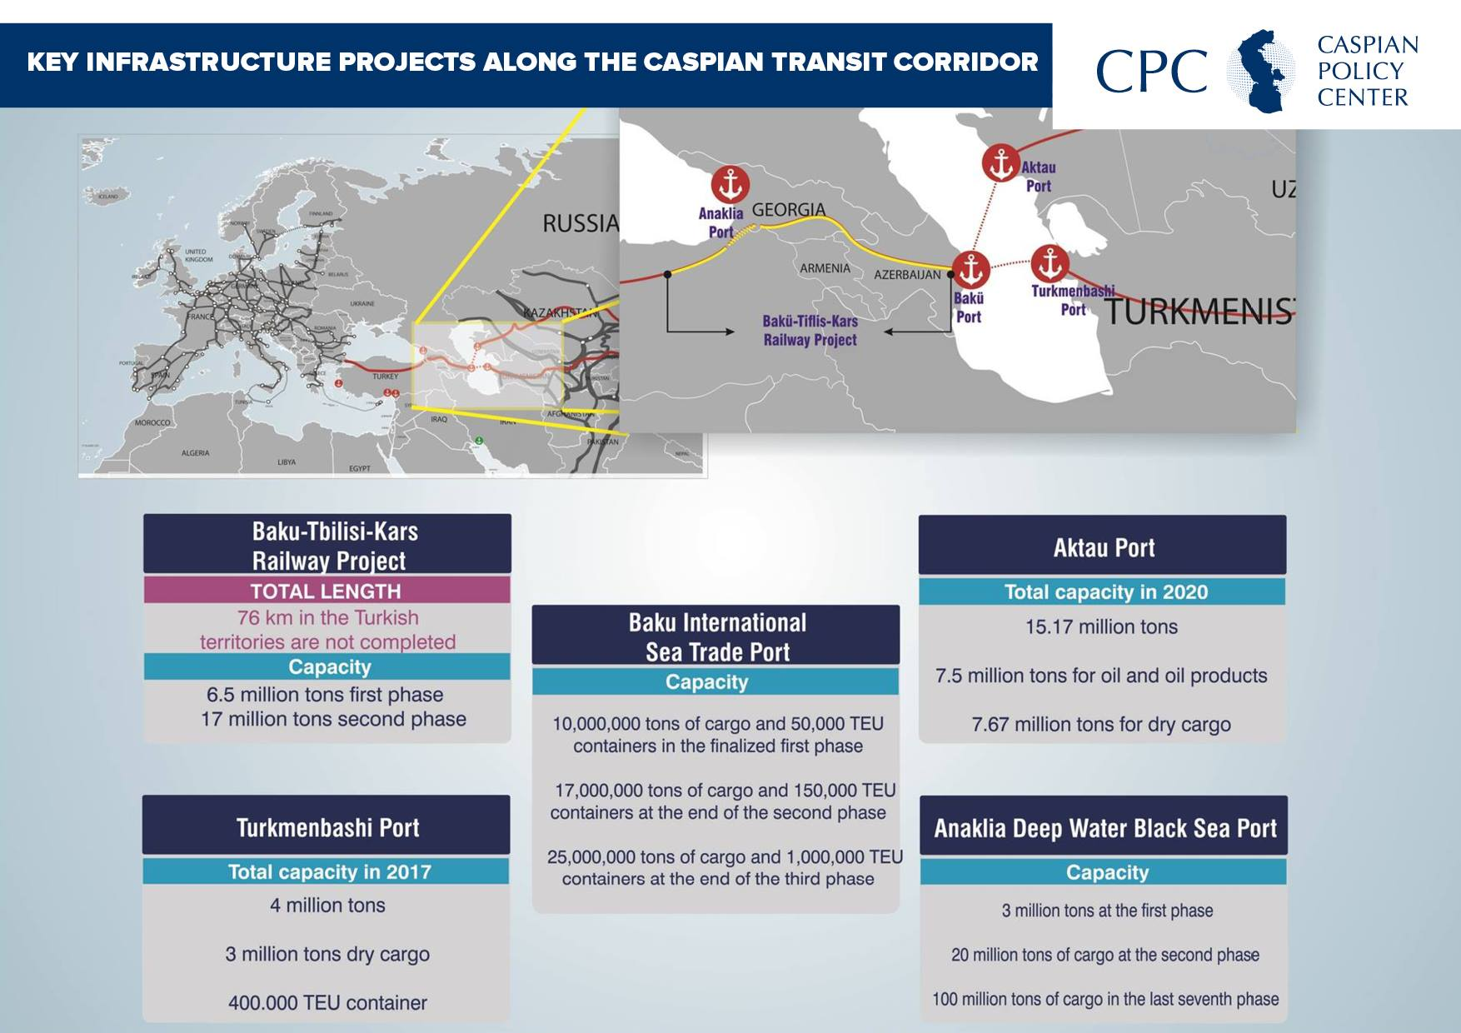

Slide 8
Energy
Hydrocarbon rich
Major projects (ACG, Kashagan, BTC, Shahdeniz etc)
Turkmenistan commitments to China
Trans Caspian
Southern Gas Corridor
Renewables (High potential, low utilization)
Environment

Slide 9
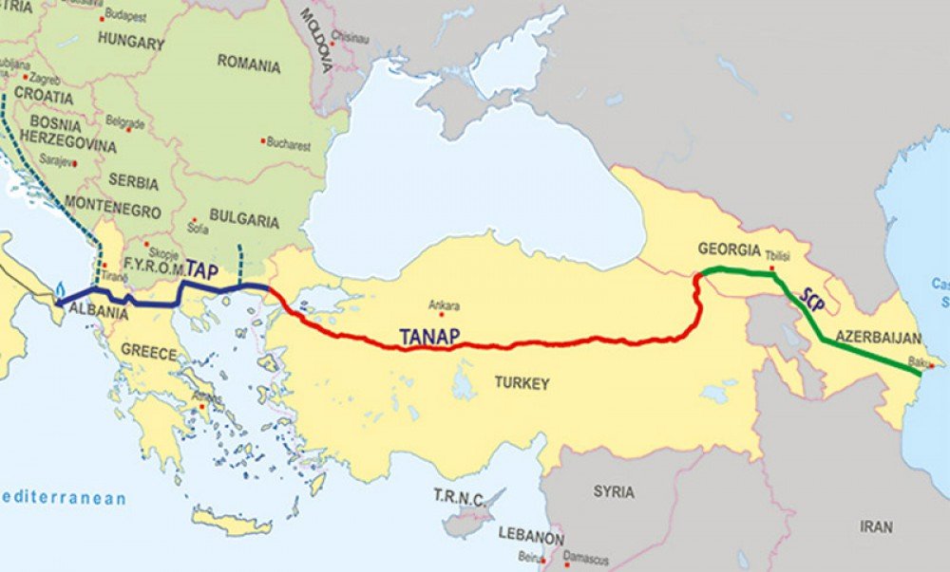
Southern Gas Corridor

Slide 10
Security and Legal Issues
- Status of Caspian, Moscow meetings
- Russia moving Caspian Fleet for Astrakhan to Kaspiisk (only 100 km away from AZ border)
- Russia firing missiles to Syria
- Conflicts (Nagorno Karabakh, Ossetia, Abkhazia)
- US/NATO supply route to Afghanistan

