Slide 1
Behavioral Interventions in Energy Consumption
Prepared for the Mason Energy Symposium
By: Joel Hicks, Ph.D. student
Schar School of Policy and Government
April 28, 2018

Slide 2
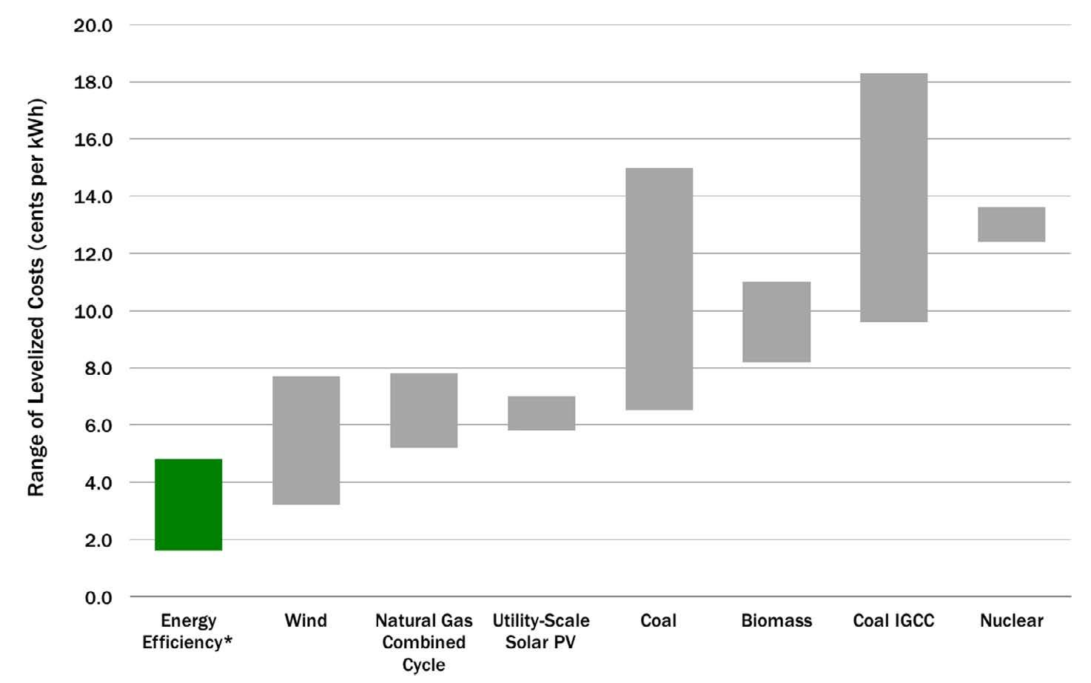
Public Policy Motivation
Controlling energy costs through demand management
Cheaper to save 1 Kwh of energy than it is to generate 1 Kwh
Why do people not invest more in energy efficiency? = ”Energy Efficiency Paradox” or “Energy Efficiency Gap”
Consumers should be more heavily rewarded for reducing demand
Rebates and other conservation programs suffer from free-ridership
Behavioral “nudges” have worked in energy conservation:
Neighbor or “peer” comparisons of energy usage (e.g. home energy reports)
Increased awareness/frequency of energy usage
Financial incentives - Pay for Performance
Loss Aversion still unexplored
American Council for an Energy Efficient Economy - eschwass, “How Much Does Energy Efficiency Cost?,” Text, ACEEE, March 17, 2016, http://aceee.org/how-much-does-energy-efficiency-cost.

Slide 3
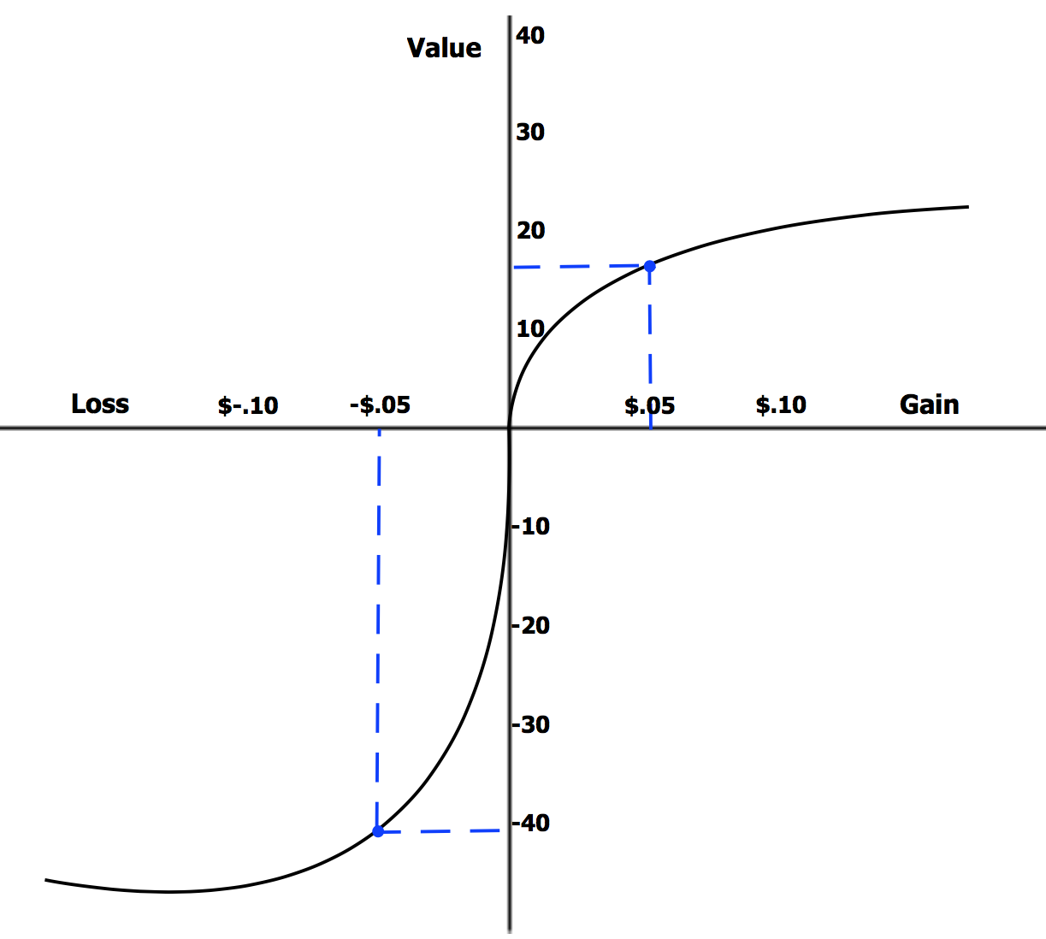
What is the theory?
Loss Aversion or The Endowment Effect
Multiple studies show that people overvalue things they already own relative to the same thing they do not own (WTP < WTA)
Use an Energy Efficiency Escrow (EEE) as a proxy for potential losses
Usage feedback
We know that increased information feedback can decrease consumption (meta-analysis of 42 studies → 7.1%)
Many caveats incl.
Frequency of feedback
Persistence
Environmental Predisposition
Daniel Kahneman, Jack L. Knetsch, and Richard H. Thaler, “Anomalies: The Endowment Effect, Loss Aversion, and Status Quo Bias,” Journal of Economic Perspectives 5, no. 1 (March 1991): 193–206, https://doi.org/10.1257/jep.5.1.193
2018 Nobel Prize in Economics Winner

Slide 4
Research Question - Hypothesis
Establish User Baselines (e.g. 12 kWh per day)
Can Loss Aversion be used as to incentivize energy conservation?
Hypothesis: Loss Aversion (through an EEE) will result in lower energy consumption relative to the same incentive given as a pay-for-performance program.
Reward users with $0.10 for every kWh below baseline
Energy Efficiency Escrow
“your average daily power usage was 12.0 kW-hr/day. We will reward you $0.10 for every kWh you save below your average. We have calculated the maximum reward you could receive by using no energy over the next 60 days. This is your energy efficiency escrow (EEE)”
(12.0 kW-hr)/day X (60 days)X ($0.1/(kW-hr))=$72.00
It will continuously decrement to reflect your actual usage. For instance, if after 60 days your average usage decreased from 12.0 kW-hr/day to 11.5 kW-hr/day your EEE will show a balance of:”
[((12.0 – 11.5) kW-hr)/day X (60 days) X ($0.1/(kW-hr))] = $3.00
Pay-for-Performance
“your average daily power usage was 12.0 kW-hr/day. We will reward you $0.10 for every kWh you save below your average.”
If average usage over the next 60 days is 11.5 kW-hr/day your reward will be:”
[((12.0 – 11.5) kW-hr)/day X (60 days) X ($0.1/(kW-hr))] = $3.00

Slide 5
Sandbridge Hall

Slide 6
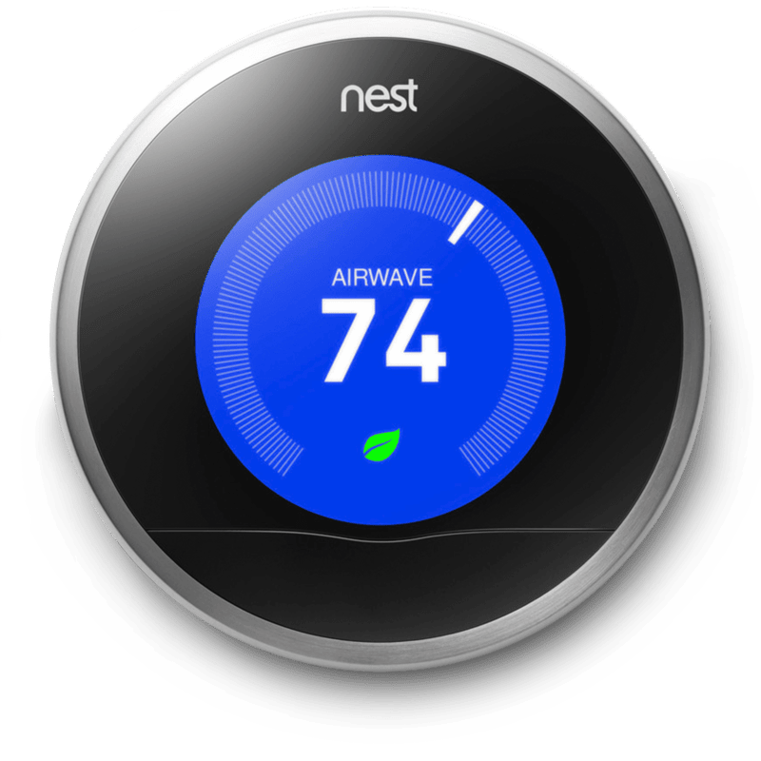
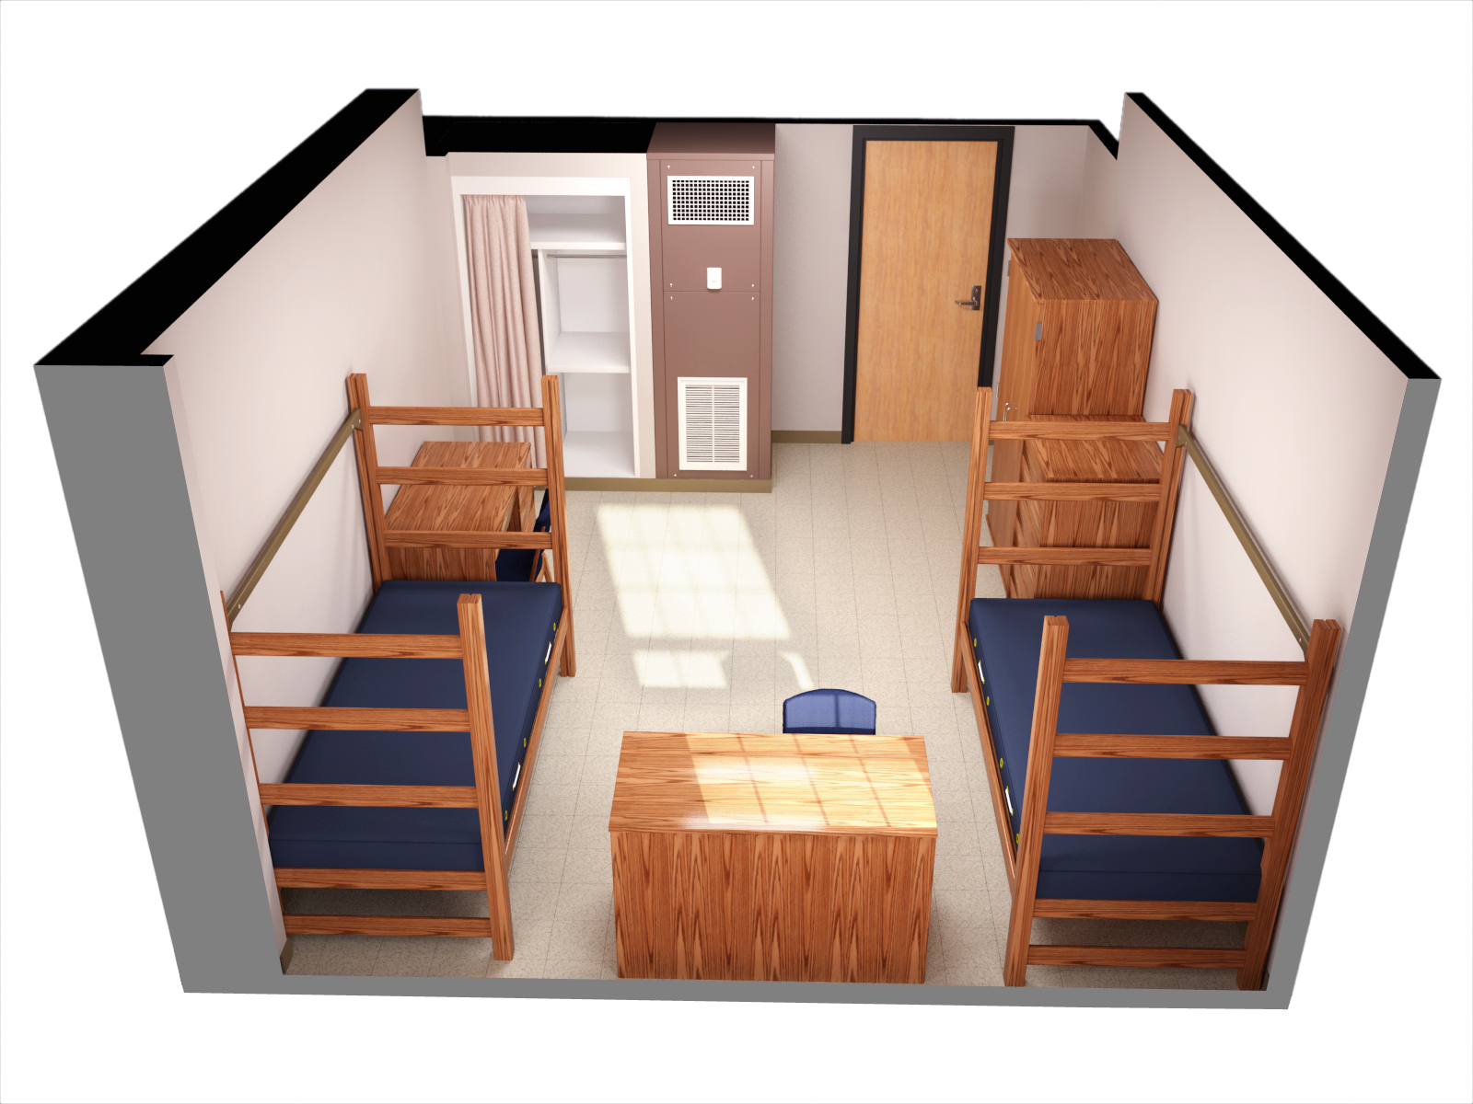
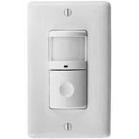
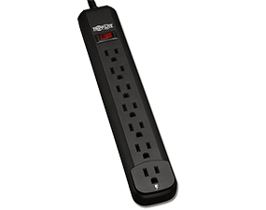
ARCHITECTURAL VIEW OF STUDY
Space Heating/Cooling
Variable loads – Monitor at PLUG level

Slide 7
Student Mobile App

Slide 8
ELEMENTS OF PILOT STUDY
Install programmable thermostats and plug-level power strips in 14-20 suites (4 students/suite)
Control group will have loads monitored….no control…..no usage
Experiment group (12-14 rooms) will have ability to 1) look at trend data, 2) receive usage comparisons with other rooms
Purpose of pilot study is to see if there are sufficient differences to justify a larger, scientific study.

Slide 9
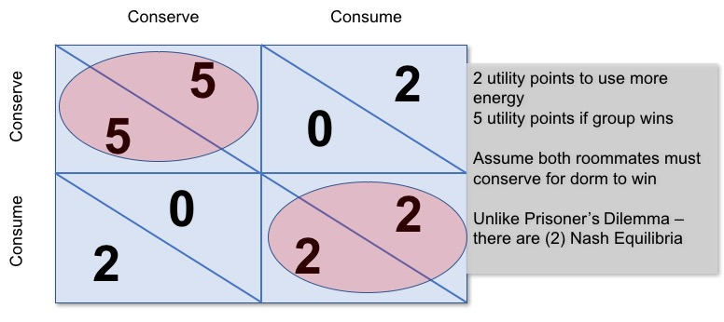
ELEMENTS OF LARGE FOLLOW-ON STUDY (2019-2020)
Research Question: Will energy consumers reduce personal consumption in a “continuously repeating” public goods competition?
Hypothesis: Students will reduce personal consumption relative to their baseline to realize a potential public gain.
Nash Equilibrium shows less than optimal social benefit is individually rational behavior

