Slide 1
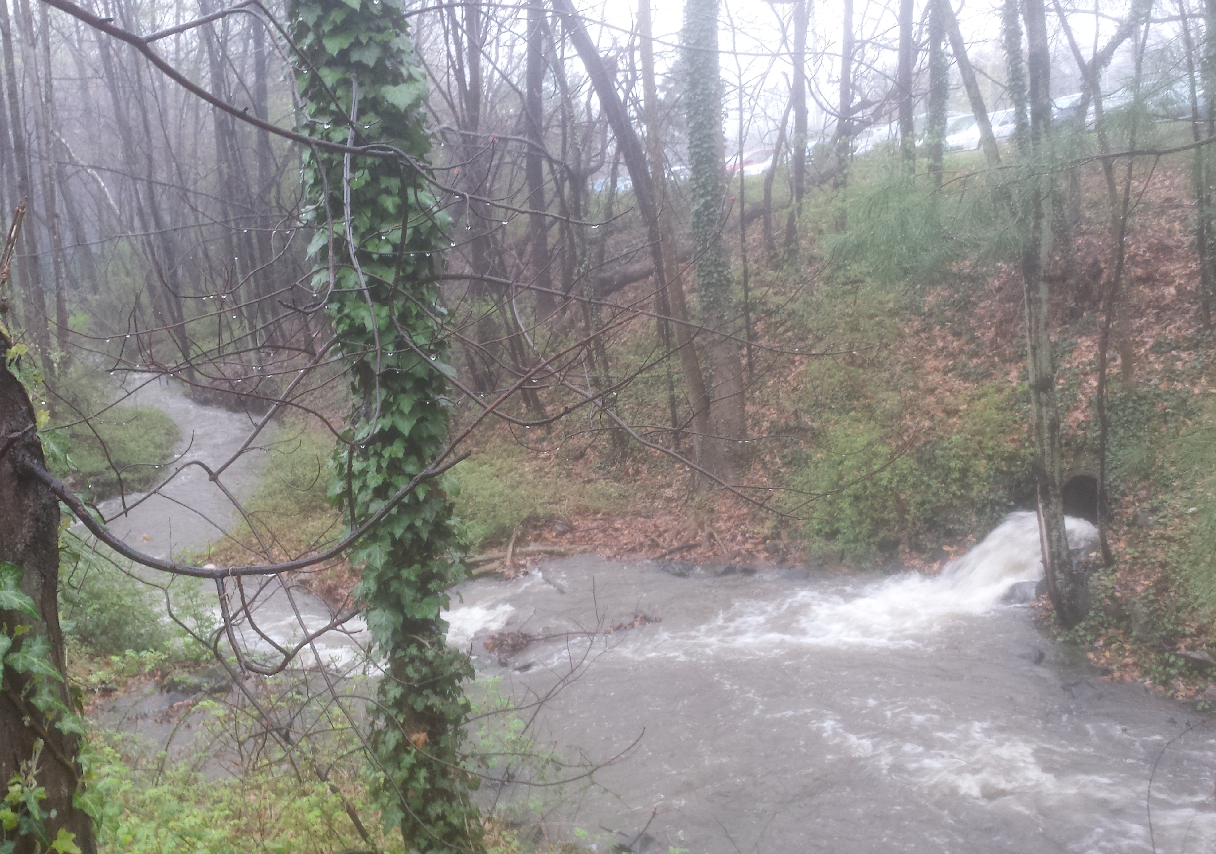
Empowering Energy-Water Nexus Resilience: Addressing Hydroelectric Micro-turbine Barriers
Jennifer Sklarew, Ph.D.
Department of Environmental Science and Policy
&
Eli Watkins
Department of Physics
Zoe Waide
Volgenau School of Engineering
Heather Nortz
Department of Environmental Science and Policy
George Mason University
Mason Energy Symposium
April 26, 2018

Slide 2
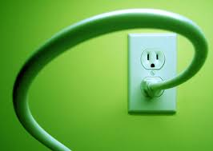
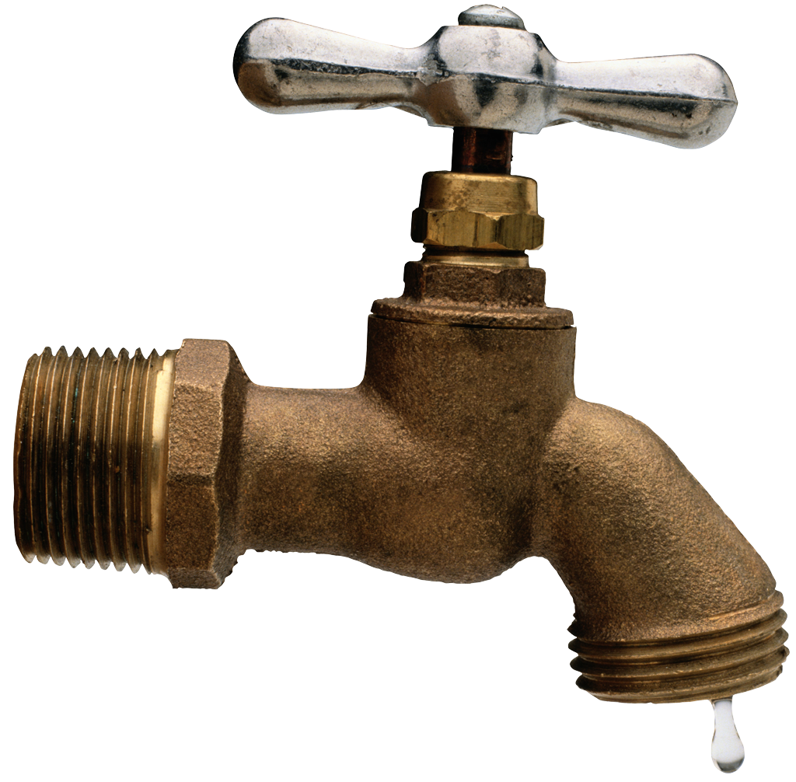
The Problem: Resilience of Interdependent Systems
Energy & water systems face many resilience challenges.
Technological & infrastructure vulnerabilities
Institutional struggles
Supply-demand balance uncertainties
System interdependence can compound these challenges.
Communities facing severe energy & water insecurity = especially vulnerable.

Slide 3
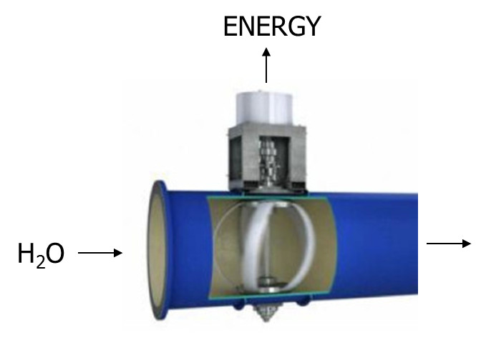
Leveraging Interdependence: Hydropower Micro-turbines as a Solution
When placed in pipes for drinking water or
storm water runoff, turbines can:
promote potable water & storm water management
concurrently bolster local electricity supply
overcome challenging trade-offs between
water & energy system resilience
Notes:
This project examines hydropower micro-turbines’ potential to leverage this interdependence to enhance resilience of both systems.

Slide 4
Research Question: Identifying and Addressing Barriers
What features are needed to deploy hydroelectric micro-turbines in urban areas facing energy and water insecurity?
Technological
Geographical
Ecological
Institutional
Socio-economic

Slide 5
Hypotheses
Challenges to hydropower micro-turbine deployment vary by location.
Institutional relationships can create, worsen or mitigate these challenges, hindering or enabling their deployment.
Creating a transparent process with community involvement in identifying solutions to local challenges can enable hydropower micro-turbine features that foster energy & water system resilience.
Notes:
Use same set of questions to start defining these for each place.
Local partners and community

Slide 6
Methodology: Phase 1: On-Campus Pilot
Build & deploy 2 micro-turbines in storm water runoff pipes on Mason’s Fairfax campus.
Identify technical, geographical, ecological, institutional & socio-economic challenges.
Identify & assess potential solutions.
Use pilot’s energy output to test & assess small-scale urban applications, e.g., emergency lighting & cell phone charging stations.

Slide 7
Multidisciplinary Approach
Project Team | Disciplines
College of Science (COS) Volgenau School of Engineering (VSE) College of Humanities & Social Sciences (CHSS) | Environmental science & policy Physics Geography & geoinformation science Forensic Science Civil, infrastructure & environmental engineering Mechanical engineering Electrical engineering Sustainability studies Global affairs

Slide 8
Student Roles in Mason Pilot
Turbine design, construction & deployment
Identify turbine construction challenges
Analyze turbine replication potential
Test & assess small-scale electricity applications
Analyze deployment challenges & solutions
Develop lessons transferable to other communities
Educational programs & signage
Promote institutional & community support
Perpetuate energy-water resilience education
Notes:
Technological
Geographical
Ecological
Institutional
Socio-economic
Classes and tours

Slide 9
Mason Pilot Candidate Sites
1. Test different flows, elevations, & pipe diameters
2. Develop different designs to meet varied site parameters
3. Test electricity applications in different locations
Outflow pipe from Mason Pond
Existing body of water
Water always present
Pipe that collects runoff from Shenandoah Parking Deck
Urban environment
Intermittent flow
Notes:
Different set of challenges

Slide 10
Rainfall and Energy Analysis: Shenandoah Parking Deck Site by Eli Watkins and Zoe Waide
Example of work:
Rainfall: .23 in/day
-> which has total volume change of
2051.75 ft^3/day
->which has total mass of
58143.83 kg/day
->which has total kinetic energy of
5711.68 kJ
-> which is 1.60 kWh

Slide 11
3 POTENTIAL DESIGNS
KAPLAN S TYPE
CROSSFLOW TURBINE
BULB TURBINE
Good for places with large variance in flow
Good for wide range of head heights
efficient at low flow
Easy to manufacture
Wide range of head heights

Slide 12
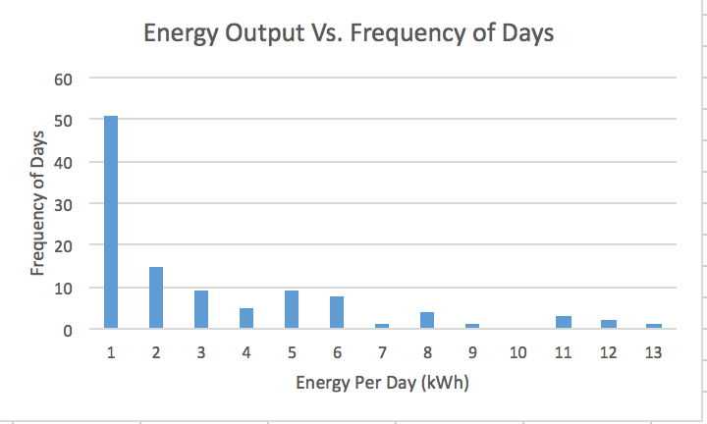
Current Energy Output Findings from Mason Pilot by Eli Watkins and Zoe Waide
Cell phone chargers use an average of 3.64 watts when charging.

Slide 13
Phase 2: International Pilot
Findings will be applied in a developing nation pilot:
Ghana
1990-2012:
+34% Power, +30% H₂O
India
1990-2012:
+28% Power, +22% H₂O

Slide 14
India’s Microhydro Turbine Use
Case Study by Heather Nortz
Existing hydroturbines are mainly used for power generation
Archived over 90 existing small to micro hydro projects
Some for mitigating flooding
Main focus on Institutional considerations
Funding comes mainly from private sector
Community involvement leads to the success of the project
Looking Forward with Mason’s pilot project
Find areas prone to flooding and in need of drinking water → assess considerations at a local level
Notes:
Created an archive of microturbine projects in India & what they were used for
Mainly power generation.
There are many turbine projects at a much larger scale in India at present (small turbines (1-25MW). Micro is defined as up to 100kW
In fact, small hydro power contributes the second largest amount of power to the grid among all renewable energies & lowest levelized cost
I touched on all of the previously mentioned considerations in my research (Technilogical, Socio-economic, ecological, geographical, and institutional) However, I mainly focused on the latter.
Who is involved in funding/ construction/ training?
World Bank-IREDA
The Bureau of Energy Efficiency
Mostly private sector
How community involvement in planning, constructing, managing, and maintenance contributed to the success of the project.
Projects in which the local community was involved in any or all of these steps were much more successful and projects without community involvement (an outside party planned and installed, then left) were neglected/ unutilized
Steps for involving the community
The next step would be to overlay areas in need of flood mitigation or drinking water with areas where a hydro turbine is not yet installed.

Slide 15
Authors and Acknowledgements
This presentation describes an interdisciplinary research project conducted by faculty members from Mason’s College of Science and the Volgenau School of Engineering: Jennifer Sklarew, Colin Reagle, Viviana Maggioni, Paul Houser, Dann Sklarew, and Celso Ferreira.
Water sensor data collection funded by a grant from Mason’s College of Science.
Mason campus turbine construction, installation, monitoring, electricity connection, and educational signage funded by a grant from Mason’s Patriot Green Fund.

Slide 16
Questions?
Jennifer Sklarew, Ph.D.
Department of
Environmental Science and Policy
George Mason University
jsklarew@gmu.edu

Slide 17
References
Ailawadi, V. S. and Subhes C. Bhattacharyya. 2006. Access to energy services by the poor in India: Current situation and need for alternative strategies. Natural Resources Forum, Vol 30, Issue 1: 2–14.
Arora, D. S. , Sarah Busche, Shannon Cowlin, Tobias Engelmeier, Hanna Jaritz, Anelia Milbrandt, and Shannon Wang. 2010. Indian Renewable Energy Status Report Background Report for DIREC 2010 NREL/TP-6A20-48948.
Brown, Dennis. Notre Dame finalizes agreement to construct hydro facility on St. Joseph River. Notre Dame News. December 12, 2016.
Clark, Alix, Mark Davis, Anton Eberhard, Katharine Gratwick & Njeri Wamukonya. 2005. Power sector reform in Africa: assessing the impact on poor people. The Graduate School of Business, University of Cape Town for ESMAP/World Bank.
Jones, Lindsey. Introduction to the Local Adaptive Capacity Framework. Overseas Development Institute.
Kellogg, Karen and Caroline Hobbs. A Case Study of Small Hydropower. The Solutions Journal. Vol. 7, Issue 1. March 16: 46-54.
Lawrence Berkeley National Laboratory. Standby Power. Standby Power Summary Table,2018, standby.lbl.gov/summary-table.html.

Slide 18
Nath, Anita. 2011. India's Progress Toward Achieving the Millennium Development Goals. Indian Journal of Community Medicine, Vol. 36, Issue 2: 85–92.
Programme Evaluation Organization Planning Commission, Government of India. November 2010. Evaluation Study on the Rajiv Gandhi National Drinking Water Mission.
Therrein, Jim. Two small hydropower sites planned in North Bennington. VT Digger. April 9, 2017. https://vtdigger.org/2017/04/09/two-small-hydropower-sites-planned-north-bennington/
United Nations Development Programme. 2012. 2010 Ghana Millennium Development Goals Report.
Water Network. 2013. Ghana Market Assessment: Market-Based Provision of Water at the Community Level, Executive Summary.
The World Bank Group. Expanding Electricity Access by Mobilizing Local Resources: Analysis of Models for Improving Rural Electricity Services in India through Distributed Generation and Supply of Renewable Energy. Mumbai. February 15, 2011.

