Slide 1
China’s BRI
What is it? What to expect?
Jack A. Goldstone

Slide 2
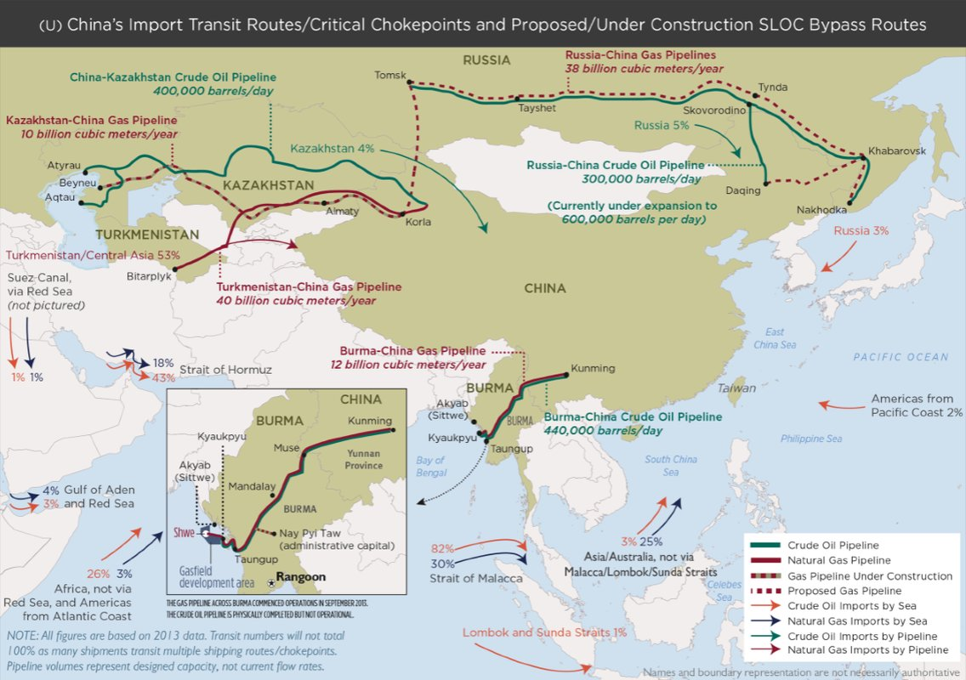

Slide 3
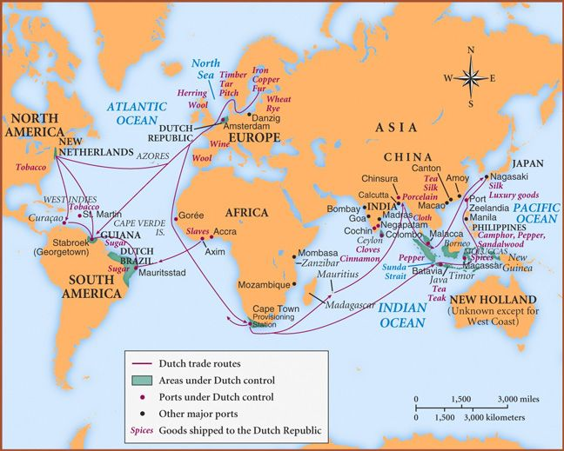

Slide 4
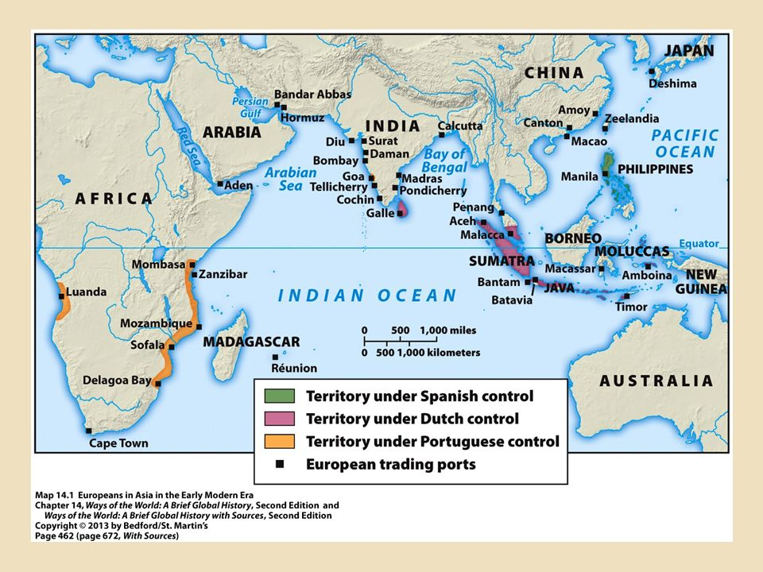

Slide 5
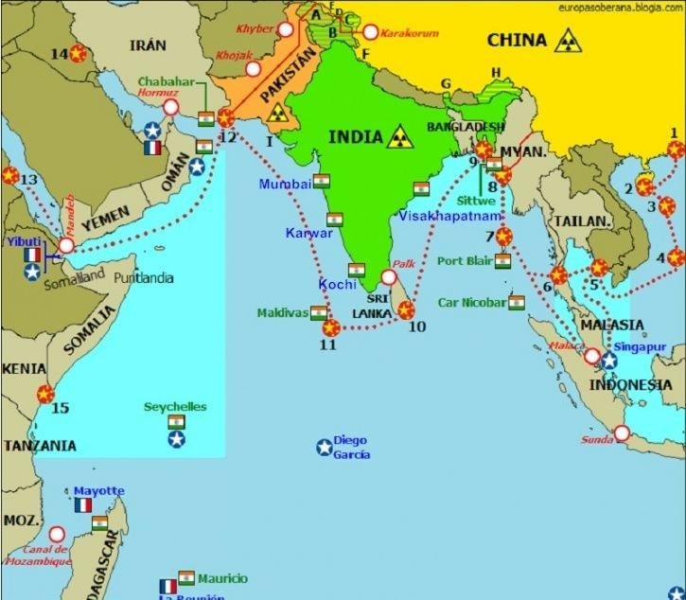

Slide 6
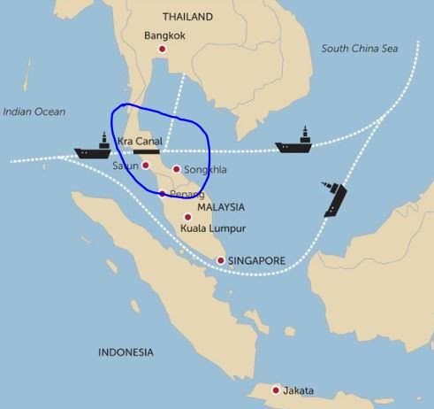

Slide 7
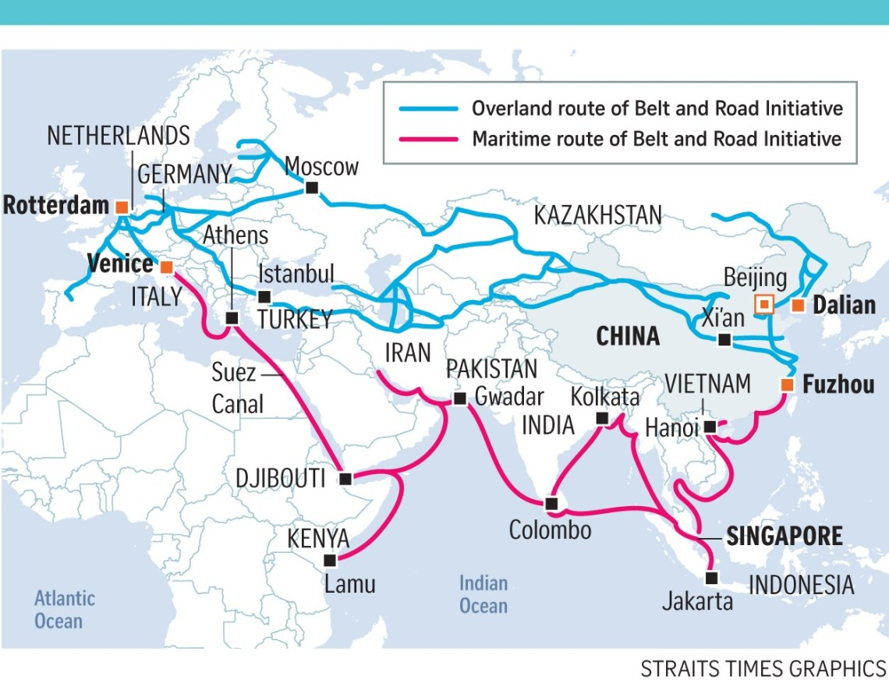

Slide 8
BRI – What is it? What to expect?
What is BRI?
Strategic plan for world domination? (sort of)
Generous plan for assistance to developing nations? (not really)
Economic plan to provide markets for excess Chinese production capacity? (definitely)
A threat to global climate via export of coal-fired power plants? (yes)
Soft power plan to spread Chinese alliances and hegemony across Eurasia? (definitely)
Nationalist campaign for reversal of the “Century of national humiliation?” (yes, at present)

Slide 9
What to expect?
BRI is an evolving set of aspirations.
It is opportunistic, and shaped by China but also by the countries where BRI projects occur.
The BRI is inseparably linked to military, geopolitical, and nationalist aspirations; this makes for significant risks of conflict.
But the BRI is in flux and can be shaped to focus on cooperative and positive global goals. That will require co-ordinated Western and allied engagement.
Energy will be a critical element of BRI: Chinese exports of electric rail, bus and cars and solar technologies and 5G and AI for energy efficiency; energy infrastructure (fossil and/or solar), and Chinese imports of oil, gas, and energy production tech and equipment. Some of the best opportunities for win/win are here.

