Slide 1
Moving the Belt and Road Initiative: From Words to Actions
Lihuan Zhou, CFA
Associate, Sustainable Finance Center
Notes:
We are a global research organization and we look at the intersection of the environment, economy and human well-being.
At the Sustainable Finance Center aims to mobilize and shift public and private sector investments toward sustainable development

Slide 2
WHAT IS THE BELT AND ROAD?
Notes:
Belt and Road Initiative, the project of the century.
What is the Belt and Road Initiative.
It's a belt and that's a series of roads so the belt is dryland
the road is actually water that's the series of ports
but it’s also includes other infrastructure as well, such as housing, oil and gas
it's even non built infrastructure like standards for telecoms
This is infrastructure that actually will help grow the economy and reduce poverty so we think the Belt and Road can be very positive but it's difficult to make it as positive as it needs to be.

Slide 3
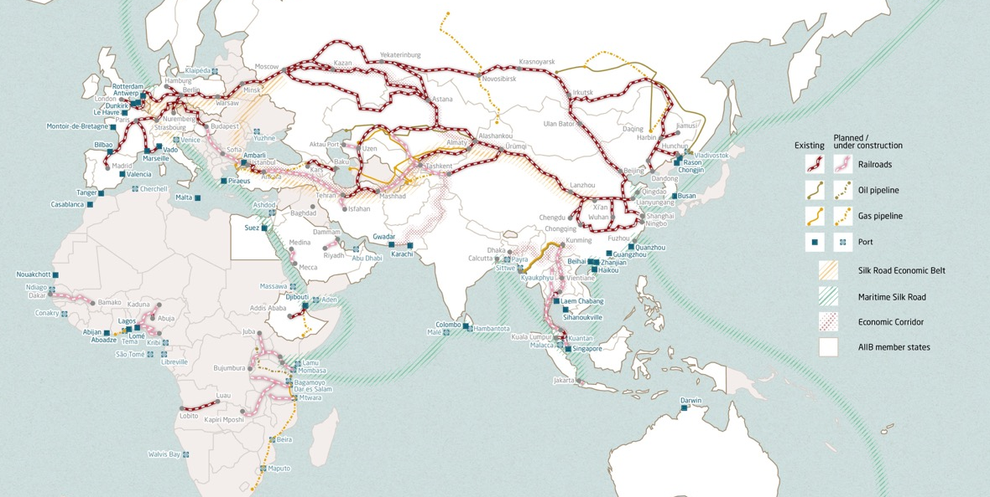
Far-reaching implications
Pulp and paper projects in Brazil
Source: MERICS
Notes:
If you try and find a map of Belt and Road you will find dozens of them and the reason for that is still the definitions are a little bit confusing and that's why this this is confusing
This is the so called a belt this is the so called Road. There are about 60-70 countries narrowly in the Belt and Road
But China says the Initiative is open to any country, and actually includes Latin America.

Slide 4
“THE PROJECT OF THE CENTURY”
Note: SRF: Silk Road Fund; CDB: China Development Bank; China Eximbank: Export-Import Bank of China
Source: Zhou, et al. 2018.
Notes:
In 2017, China hosted the first international forum on the Belt and Road Initiative. It made $113 billion dollars financing commitment to build infrastructure in Belt and Road countries..
Wholly state-owned financial institutions received about $70 billion dollars as special funds, including the Silk Road Fund, CDB, and China Eximbank. Silk Road Fund behaves like a private equity fund and mainly does equity investing. CDB and China Eximbank mainly provide loans.
China also encourages commercial banks, especially the big-four state-owned commercial banks to provide finance in Chinese Yuan.
The actual investment volume could be even larger if the policy and commercial banks blend government money with their own resources.
We think China can play a massive role in meeting green infrastructure needs worldwide, but only if it can align its financial flows with low-carbon investments in Belt and Road Countries.

Slide 5
ENORMOUS OPPORTUNITY FOR renewable energy
Source: Zhou et al. 2018
Notes:
To understand the scale of the investment opportunity for China, we put some numbers on the table.
In a collaboration with colleagues at Boston University, we examined BRI countries' national climate plans, or "Nationally Determined Contributions (NDCs)," submitted as part of the Paris Agreement on climate change.
We initially wanted to cover 68 BRI countries, however, we found only 31 of them had quantitative targets in NDCs for us to estimate the financing required to meet them.
We found enormous opportunities. Those 31 countries alone will need about $470 billion just to implement renewable energy commitments. About half of that would finance solar photovoltaic (PV) projects, and 40 percent would go to wind and hydropower.

Slide 6
CHINA PUSHES FOR AN ECOLOGICAL CIVILIZATION
“Green Belt and Road …incorporates eco-environment protection into all aspects and whole process of the Belt and Road”
—Guidelines on Promoting Green Belt and Road
Photo: UN Photo/Loey Felipe
Notes:
China is pushing for what it calls ecological civilization. When President Xi Jingping says green is the new gold he actually does get the fact that the economy will benefit if they reduce air pollution and they address climate change and become more resilient and so on.
For example, China has turned to renewable energy natural gas to meet its energy demand and is increasingly pushing for electric vehicle.
So they want to do what it calls ecological civilization and the real question is can they do that for the belt and road just as they're trying to do for China domestically

Slide 7
Energy investments not aligned with climate goals
Notes: a: Syndicated loans by the six Chinese banks are total loan amounts of projects in which the six Chinese banks participated. The actual loan contributions by individual banks were not available for many of the transactions. The six Chinese banks are China Development Bank, Export-Import Bank of China, Agricultural Bank of China, Bank of China, China Construction Bank, and Industrial and Commercial Bank of China. b: SRF includes four project investments that disclose investment amounts.
Source: Zhou et al. 2018
Notes:
We have done some analysis at the moment and it doesn't look where it needs to be
These are the different sources of funds from China for the Belt and Road
there's the syndicated loans by the six Chinese banks
there are those that are exclusively financed by China Development Bank and Exim Bank
there's a silk road fund
then there are non-financial state-owned enterprises and private-owned enterprises
Describe the meaning of colors.
So you see it's not where it needs to be quite frankly besides the POEs.
Internal resource, then project size, natural fit.
There's an important point here because China would say with some legitimacy is it's not for them to go and preach to countries what they do around the globe
This is what's being requested by these countries. So it's actually a little bit more complicated but this story is not encouraging.
When Andrew presented these data to the Chinese government, it was very interested in this because the Belt and Road doesn't have a real central control and coordination
It's quite actually disaggregated and so one of the interesting things will be is there more of a kind of centralized data point for Belt and Road

Slide 8
Various types of financing can be blended
Source: Zhou et al. 2018
Notes:
IDCA: International Development Cooperation Agency

Slide 9
Various types of financing can be blended
Note: ACWA = Saudi Arabia utility developer ACWA Power; DEWA = Dubai Electricity and Water Authority; CTGC = China Three Gorges Corporation; NCB = Saudi Arabia National Commercial Bank, UNB = UAE Union National Bank, FGB= First Gulf Bank.
Source: Zhou et al. 2018
Notes:
Chinese financial institutions and enterprises offer different types of financing.
There are possible interactions that can occur across different types of Chinese overseas financial flows.
Some projects may only involve one type, but various types can be implicitly blended together in many ways.
Here we provide two examples for the financing structures.
The left one is the Hassyan coal-fired power plant in UAE. Describe financing structures
The right one is the Karot hydropower plant in Pakistan. Describe financing structures

Slide 10
Policy signal matters
Source: Zhou et al. 2018
Notes:
Describe chart
2015, State Council issued the Vision and Proposed Actions on Jointly Building the Belt and Road

Slide 11
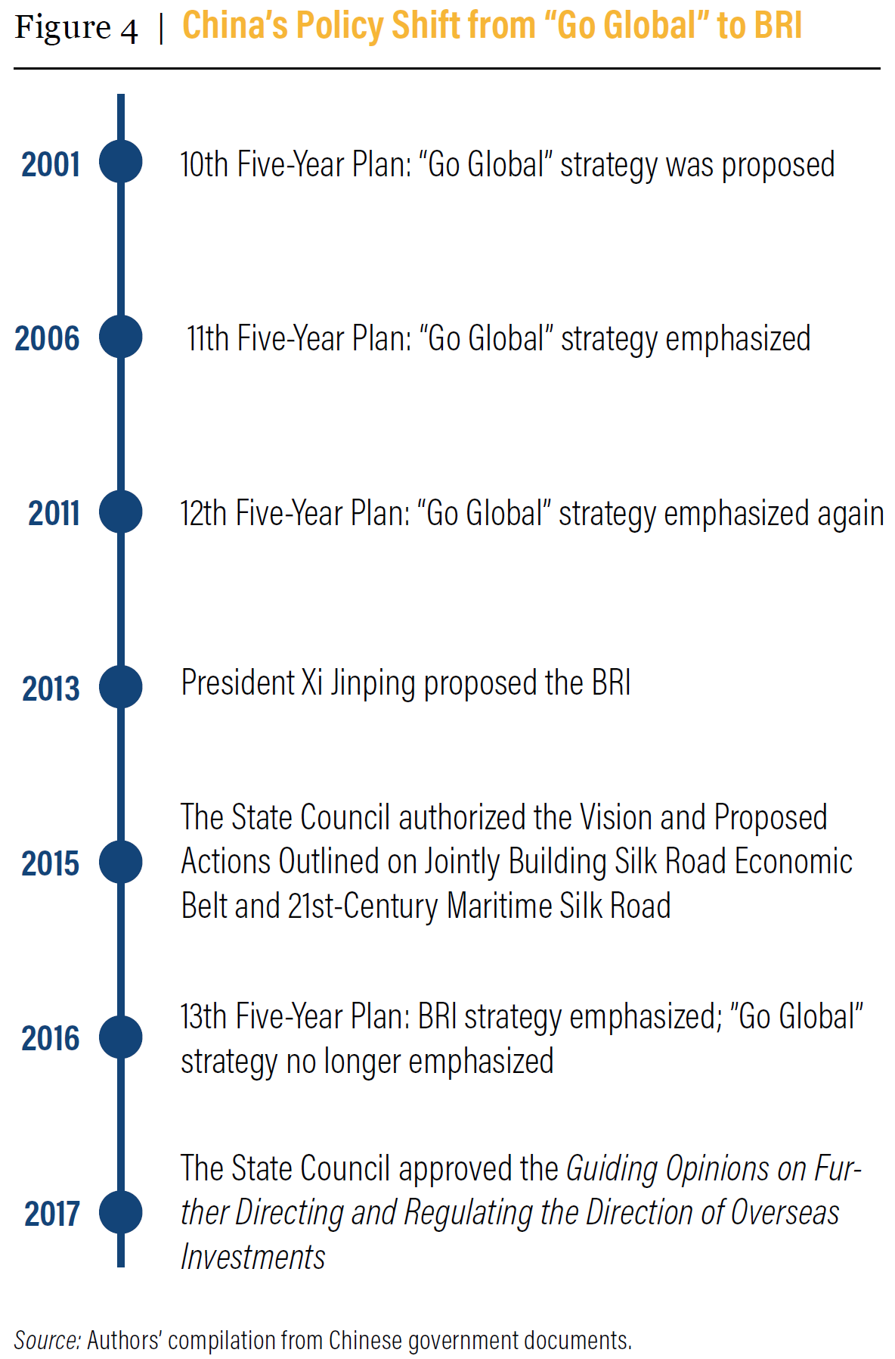
Policy signal matters
Source: Zhou et al. 2018
Notes:
Describe chart
2015, State Council issued the Vision and Proposed Actions on Jointly Building the Belt and Road

Slide 12
Will Belt and Road Forum Produce Sustainability Guidelines?
APRIL 25-27 2019: Beijing
Image: The Russian Presidential Press and Information Office/Wikimedia Commons
Notes:
In late April this year, there will be the second Belt and Road Forum that brings heads of state and ministers and key players together.
The Chinese government made clear its intention to incorporate green strategies into the BRI in the first Belt and Road Forum, e.g. the Guidelines on Promoting Green Belt and Road. These documents outline a vision for sustainability, but they are pitched at a high conceptual level.
The question is will sustainable development really be clear this year?
BRI International Green Development Coalition: Thematic Partnership
Green Finance and Investment
IISD and Tsinghua

Slide 13
Download our paper at: https://www.wri.org/publication/moving-green-belt-and-road-initiative-from-words-to-actions

