Slide 1
EPA’s Climate Pollution Reduction Grants
Andrea Denny
Lead Environmental Policy Analyst, State and Local Climate and Energy Program, Office of Atmospheric Protection, Office of Air and Radiation
U.S. EPA

Slide 2
tackling climate and Air pollution from multiple angles
Sector-based:
Mobile Sources
Clean School Bus program
Clean heavy-duty vehicles
Clean ports
Diesel Emissions Reductions
Top-down:
Climate Plans
Climate Pollution Reduction Planning and Implementation Grants
Bottom-up:
Environmental Justice (EJ)
Env. & Climate Justice Program
Thriving Communities Program
EJ Govt.-to-Govt. Program
Collaborative Problem-Solving Coop. Agreement Program
Sector-based:
Stationary Sources
Methane Emissions Reduction Program
Funding to Address Air Pollution / Air Monitoring
*Not exhaustive
2

Slide 3
Climate Pollution Reduction Grant (CPRG) Program
1. Planning grants to develop strong climate pollution reduction strategies ($250 million)
2. Competitive implementation grants to help put plans into action ($4.6 billion)
https://www.epa.gov/inflation-reduction-act/climate-pollution-reduction-grants

Slide 4
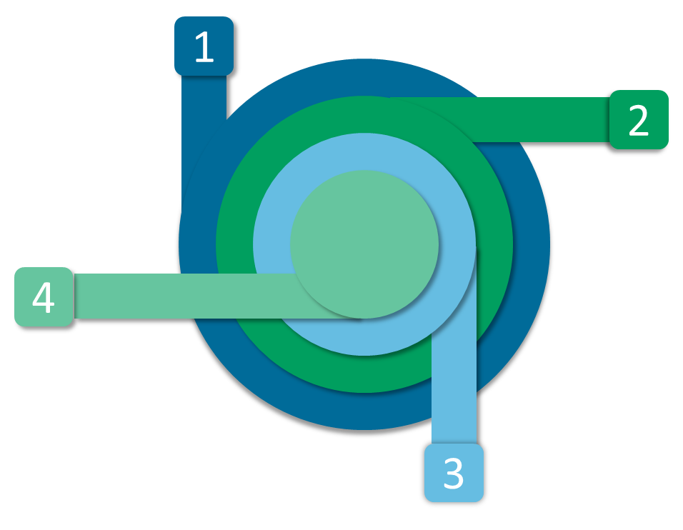
Planning Grant Allocations
States: $156 million
Up to $3M per state + DC + Puerto Rico
Locals: $67 million
Up to $1M each for the 67 most populous metropolitan areas
Territories: $2 million
Up to $500K each for US Virgin Islands, Guam, American Samoa, Northern Mariana Islands
Tribes: $25 million
Up to $500K per tribe or $1M for groups of 2 or more

Slide 5
Notice of Intent to Participate Status
NOIP Submitted
NOIP Not Submitted

Slide 6
One planning grant, three deliverables over 4 years
Priority Climate Action Plan (PCAP)
Comprehensive Climate Action Plan (CCAP)
Status Report
Due March 1, 2024
Near-term, implementation-ready, priority greenhouse gas (GHG) reduction measures
Prerequisite for implementation grant
Due in 2025 (later for tribes and territories)
All sectors / significant GHG sources and sinks
Near- and long-term GHG emission reduction goals and strategies
Due in 2027 (N/A for tribes or territories)
Updated analyses and plans
Progress and next steps for key metrics

Slide 7
Intergovernmental and Stakeholder Coordination
Lead agencies must coordinate with other appropriate agencies and offices within their own government in the development and adoption of the deliverables.
Lead agencies must conduct meaningful stakeholder engagement
State Requirements
Collaborate with air pollution control agencies, and municipalities within the state to develop the PCAP and over the duration of the grant
Identify and include priority measures in the state PCAP that can be implemented by collaborating entities (e.g., municipalities, air pollution control agencies, collaborating tribes)
Metropolitan Area Requirements
Climate plans should also be developed with regional coordination as much as possible

Slide 8
Potential Roles for Universities and Municipalities
Universities could support municipal and public engagement
Convene/Facilitate stakeholder meetings; advisory committee(s)
sub-awards to support municipal planning (either directly to municipalities or to a 3rd party);
analysis or modeling to identify promising municipal GHG reduction measures;
Strategies for Municipalities to Engage with their States
reach out to state contacts to learn more about how they intend to conduct this coordination
monitor state websites or newsletters for announcements about coordination, training, or capacity-building opportunities
collaborate with neighboring communities or municipal groups to identify shared priority GHG reduction measures and best practices that can inform state plans
share existing municipal climate, energy, or sustainability plans, programs, and policies with the state

