Slide 1
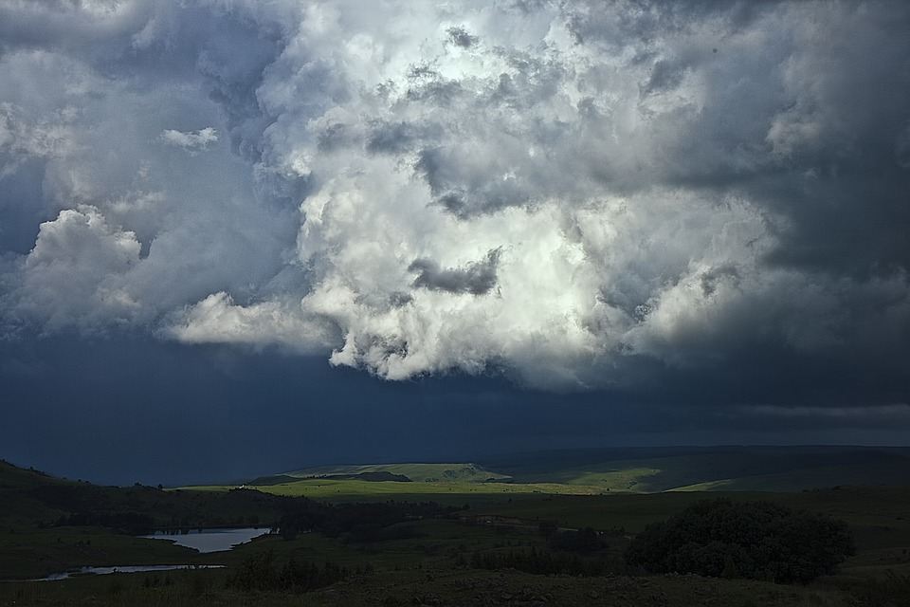
PA DEP Local Climate Action Program
Olivia McMahon​​
.April.17.2023

Slide 2
Agenda
LCAP Background​
Team
Semester I – Activities, Challenges and Successes​
Semester II -​ Activities, Challenges and Successes
Takeaways

Slide 3
Background
The Pennsylvania Climate Change Act of 2008 directed the PA DEP to produce a statewide inventory of greenhouse gas (GHG) emissions and set statewide reductions targets.
The Local Climate Action Program (LCAP) began as an initiative of the DEP with financial support from the US Department of Energy.
Participating municipalities are paired with college students who receive training and support from ICLEI Local Governments for Sustainability to inventory emissions and develop local climate action plans .
In 2022 , Penn State took leadership of the LCAP in long term in partnership with DEP and ICLEI.
Bucks County is participating in the LCAP as a complement to ongoing sustainability planning.

Slide 4
The Team
Christopher Nafe
Energy Specialist
Eli Yewdall
Senior Program Officer
Neale Dougherty
Director of Sustainability
Cassandra Goodmansen
Environmental Planner
Doctor Peter Buck
Professor
Brandi Robinson
Jonaid Lone
Graduate Student
Olivia McMahon
Undergraduate
4/17/2023
4/17/2023
MACCA 2023

Slide 5
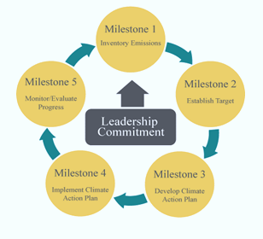
Framework
Semester I
Semester II

Slide 6
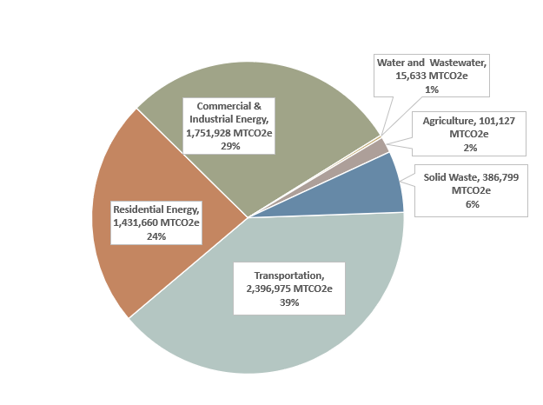
Semester I
Semester I
Text messages
Social media
Message boards
Virtual reality
Priorities
Accuracy
Repeatability

Slide 7
Semester I
Scavenger hunt for puzzle pieces
Lost time searching for possible data collection strategies
Prior knowledge of likely issues would be beneficial
Protocol for contacts
Where to direct questions
ESP Curriculum
Researching Municipality
Policy Memos
Discussion board for questions
Fantastic Support across the board
Challenges
Successes
MACCA 2023

Slide 8
Semester II
Activities
Review of other CAPS
Outreach to other municipalities
Stakeholder input
Recommend
actions for
County
Government
Operations

Slide 9
Semester II
Finding the best path forward
Stakeholder engagement
Should have started immediately
Data Acquisition
Time constraints
Review of other plans
Meeting with other municipalities
Flexibility
Lunchtime Zoom Meetings
Challenges
Successes
MACCA 2023

Slide 10
Key Takeaways
The more information that can be given up front the better
Flexibility is invaluable
Collaboration
Students and Professors
Collaboration
Between Municipalities
Collaboration
Academia and Municipalities

Slide 11
Thank You​

