Slide 1
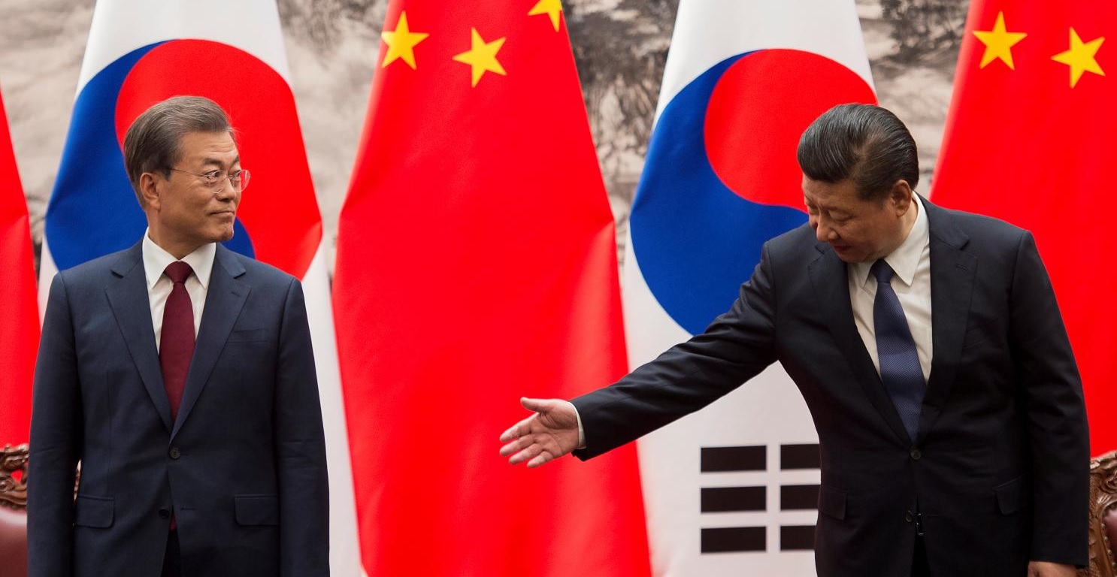
The Korean Perspective on Belt and Road
From an Energy Security Lens
Thursday, April 25, 2019
George Mason University (GMU), Center for Energy Science and Policy
3rd Annual Mason Energy Symposium – China’s Belt and Road Initiative
Alan Ahn
Director of Programs and Communications, Global America Business Institute (GABI)
Notes:
Personal introduction
Thanks to Greg; always enjoy doing this
Aim: go through quickly, leave time for questions
Hit the high points; avoid the weeds

Slide 2
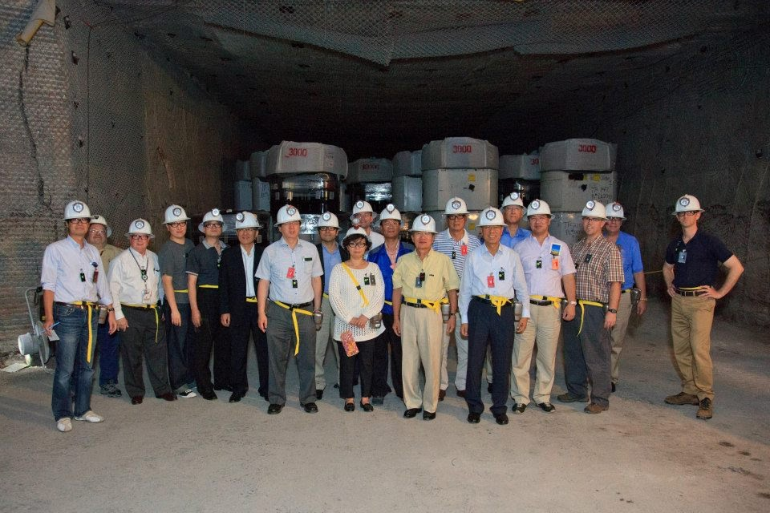
Overview of the Global America Business Institute (GABI)
Founded in May 2011
Forum for energy policy issues
  Roundtables, briefings, workshops, high-level dialogues
  Publications, podcast interviews, surveys
  Key issues: nuclear power, clean and renewable energy, etc.
At WIPP: Korea-Japan-US Trilateral Nuclear Energy Dialogue, Summer 2012

Slide 3
Disclaimer
Any views or opinions expressed in this presentation are strictly my own and do not necessarily reflect the positions of GABI or its affiliates and partners

Slide 4
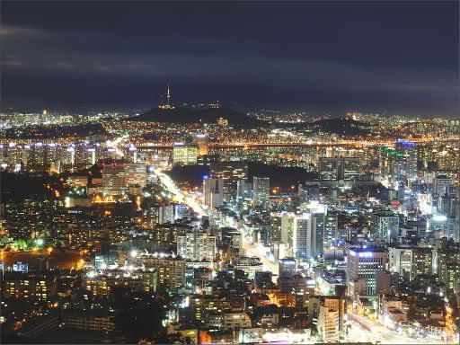
Miracle on the Han

Slide 5
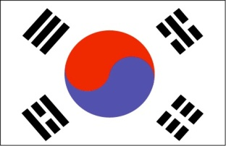
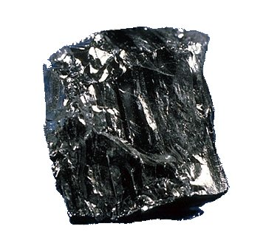
Energy Resource Scarcity in Korea
Virtually no oil
Limited natural gas reserves
Small anthracite coal production
  Major energy source prior to the 1990s
  Not generally used for power generation
  Low mine productivity and high labor costs have scaled back production
Mineral resources largely concentrated in North Korea
Anthracite coal

Slide 6
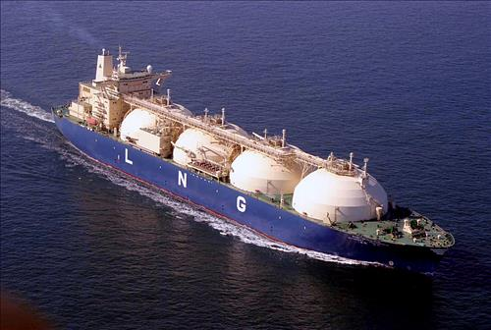
High Energy Important Dependence
Latest U.S. Energy Information Administration (EIA) Statistics:
9th Largest energy consuming country in the world
Imports 97% of its primary energy
Korea is the world’s…
3rd largest importer of liquefied natural gas (LNG)
4th largest importer of coal
5th largest net importer of petroleum and other hydrocarbons
LNG Tanker owned by Hyundai Merchant Marine

Slide 7
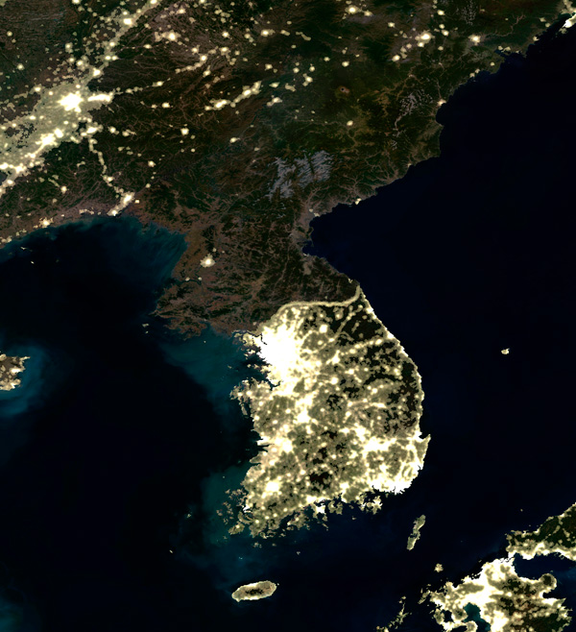
South Korea as an Energy/Electricity Island
No electrical grid connections
  Unable to import electricity
  Must generate its own electricity needs within a densely populated, limited geographical space
  Acute NIMBY issues
  Problematic for plant siting and renewable energy deployment
No oil/gas pipeline connections
  Completely reliant upon tanker shipments of LNG and oil
  Magnify energy import costs

Slide 8

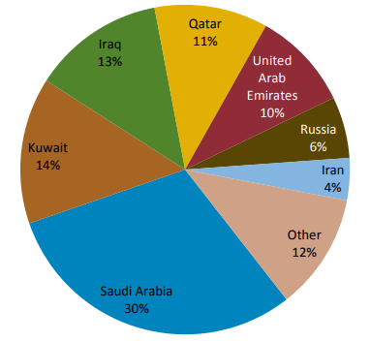
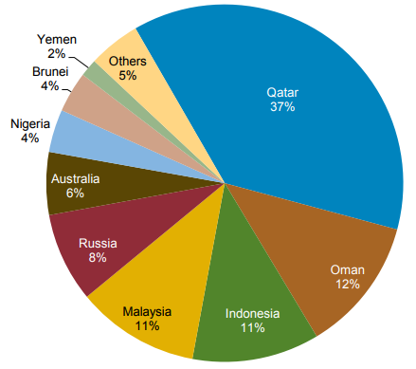
Dependence on Middle East Suppliers
Oil and gas imports have historically been dominated by a limited number of Middle East suppliers
2015 CRUDE OIL IMPORTS
2015 LNG IMPORTS
Source: Korea Customs and Trade Development Institute
Source: IHS Energy

Slide 9
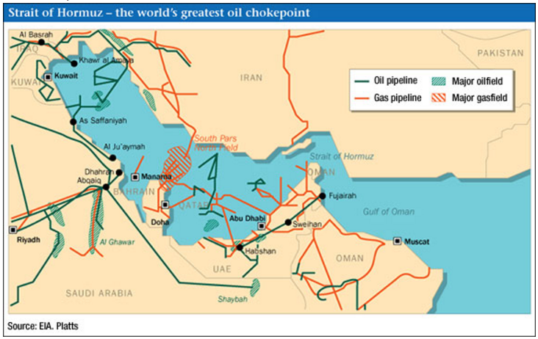
Dependence on Middle East Suppliers
Heightened sensitivity to geopolitical instability in the Middle East
Strait of Hormuz
17 million barrels of oil per day (20% of global demand)
82 million tons of LNG (30% of global demand)
Roughly 85% of oil imports to ROK passes by this area

Slide 10
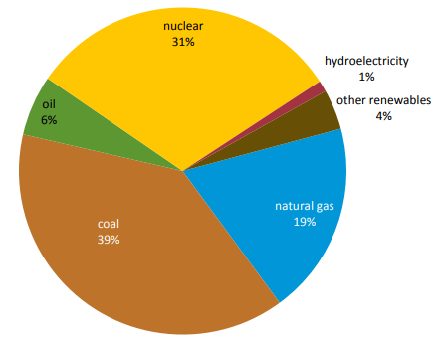
Republic of Korea Electricity Generation Mix
Source: Korea Electric Power Corporation (KEPCO), 2016 Annual Report

Slide 11
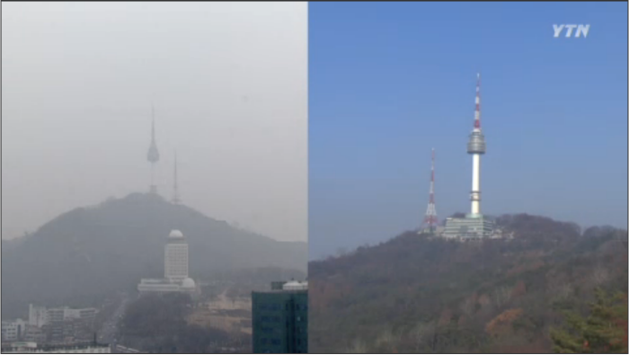
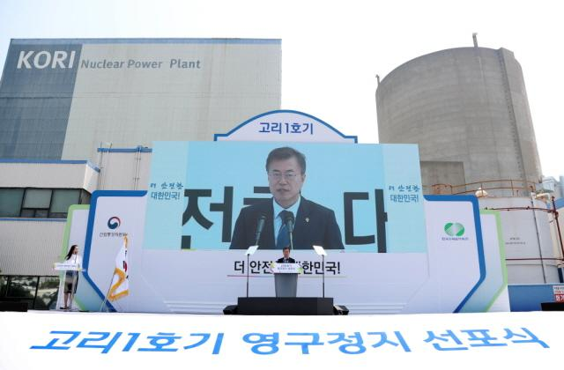
Korea’s Current Energy Dilemmas
Underpinnings of Korea’s traditional energy strategies are being challenged
GROWING ENVIRONMENTAL IMPERATIVES
Fine dust and particulate emission issues are major societal and health problems
Korea must demonstrate leadership in international climate change mitigation efforts by reducing its carbon emissions
ONGOING SOCIETAL DEBATES ABOUT NUCLEAR
The Fukushima accident in Japan and a number of domestic incidents have affected public perception
Citizens commission supported both continuation of nuclear construction and long-term reductions in nuclear energy
Worsening air quality issues throughout Korea
President Moon Jae-In at the permanent shutdown of Kori-1

Slide 12
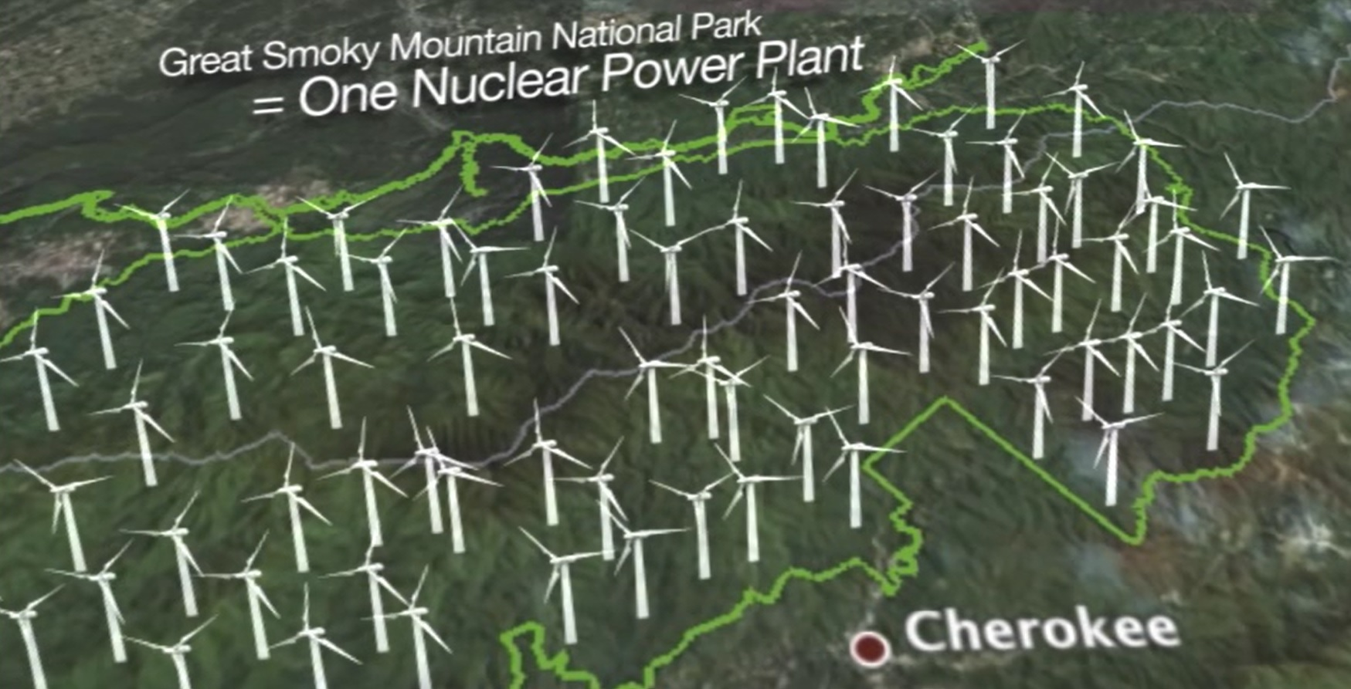
Challenges for Renewable Energy Deployment in Korea
Source: Screenshot from Powering America, The Heritage Foundation

Slide 13
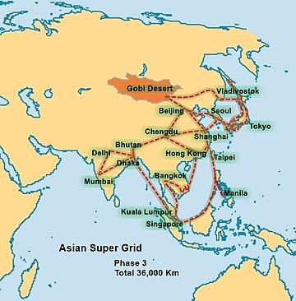
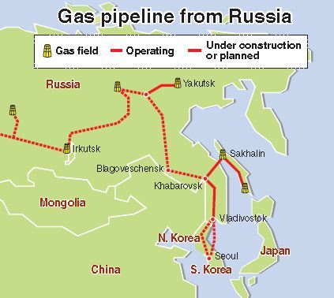
Benefits of Potential Regional Integration
Asian Super Grid (ASG) Proposal
Renewable Energy Institute (REI) map
Russian Trans-Korean Gas Pipeline Proposal

Slide 14
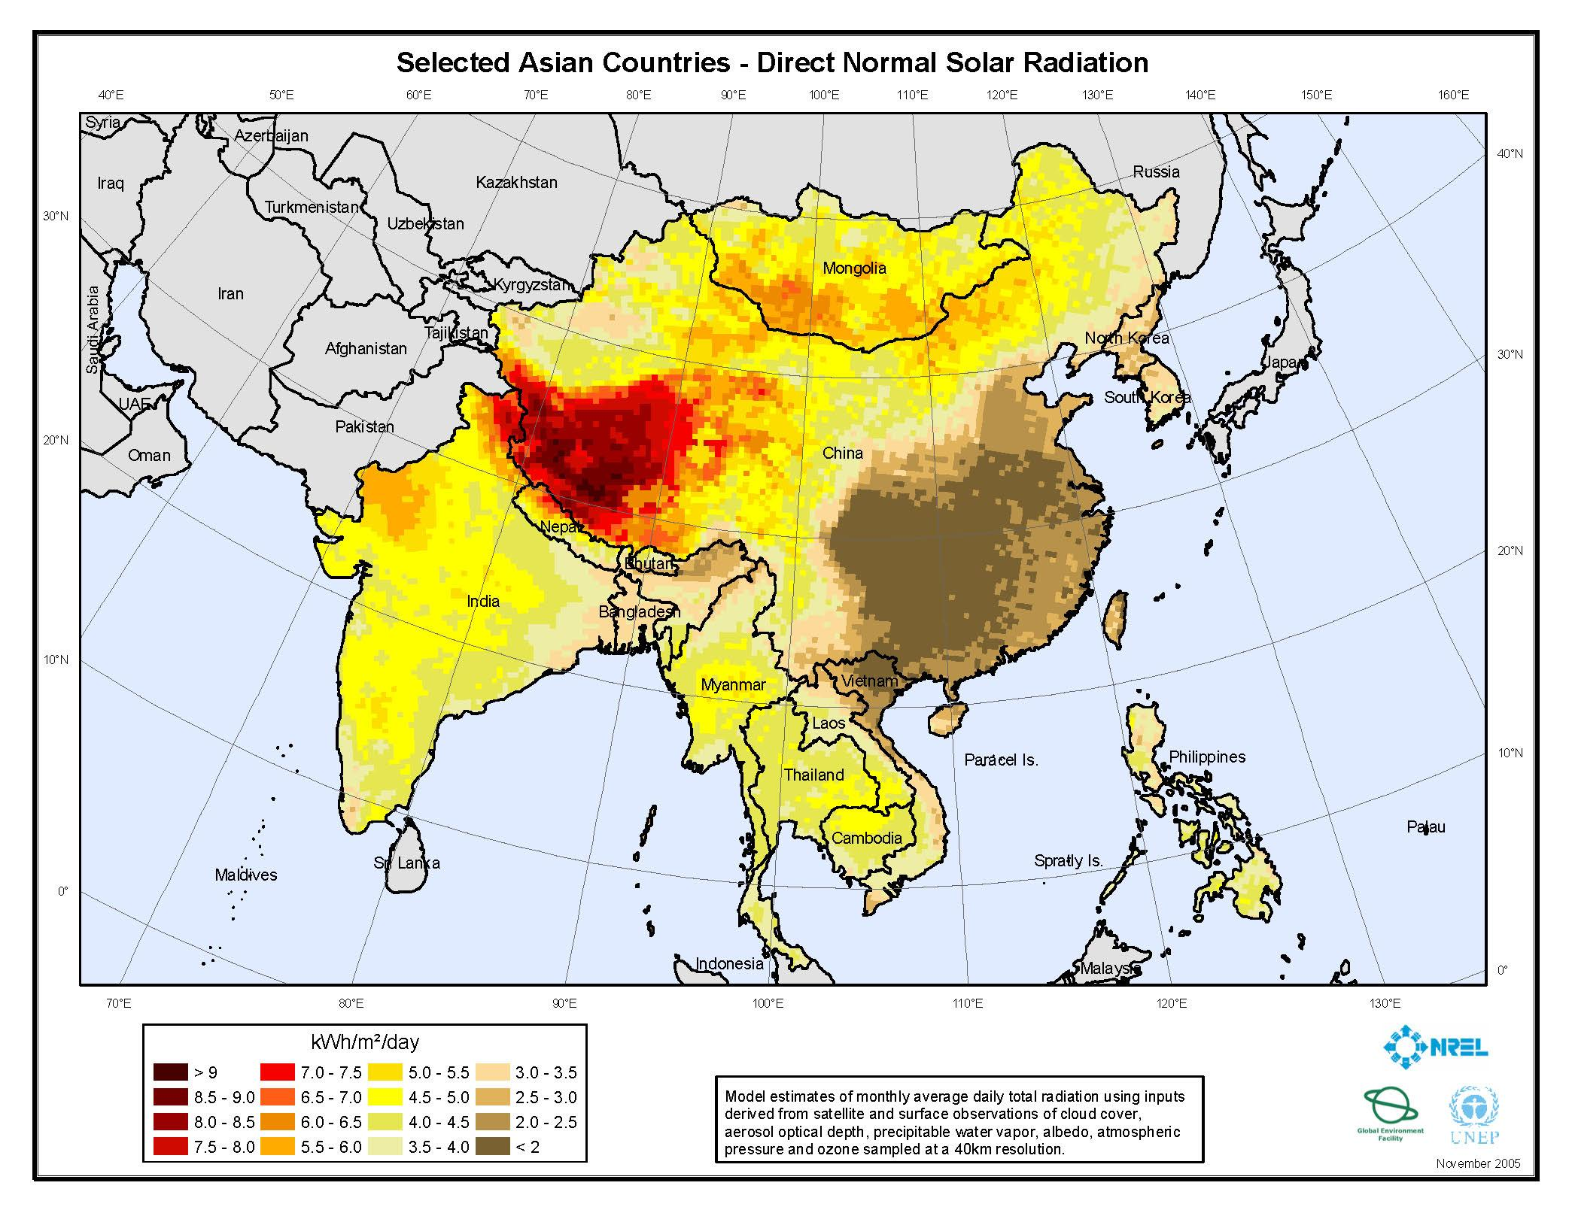
Benefits of Potential Regional Integration
Solar Energy Potential in Asia
Source: National Renewable Energy Laboratory (NREL)

Slide 15
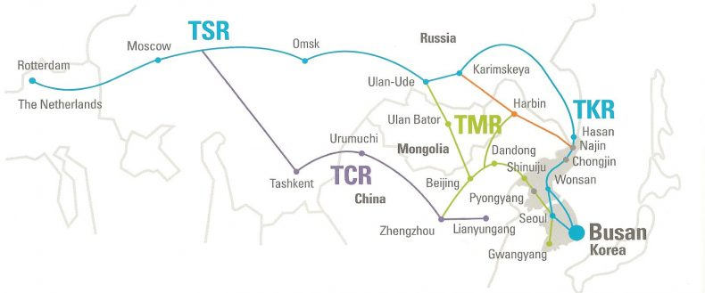
The Lure of Belt and Road
In theory, buildout of infrastructure (road, rail, grid, pipeline) connecting the Eurasian landmass facilitates Korea’s access to the more abundant energy resources (renewables, oil, gas) of the continent
Source: itrailnews.co.kr

Slide 16
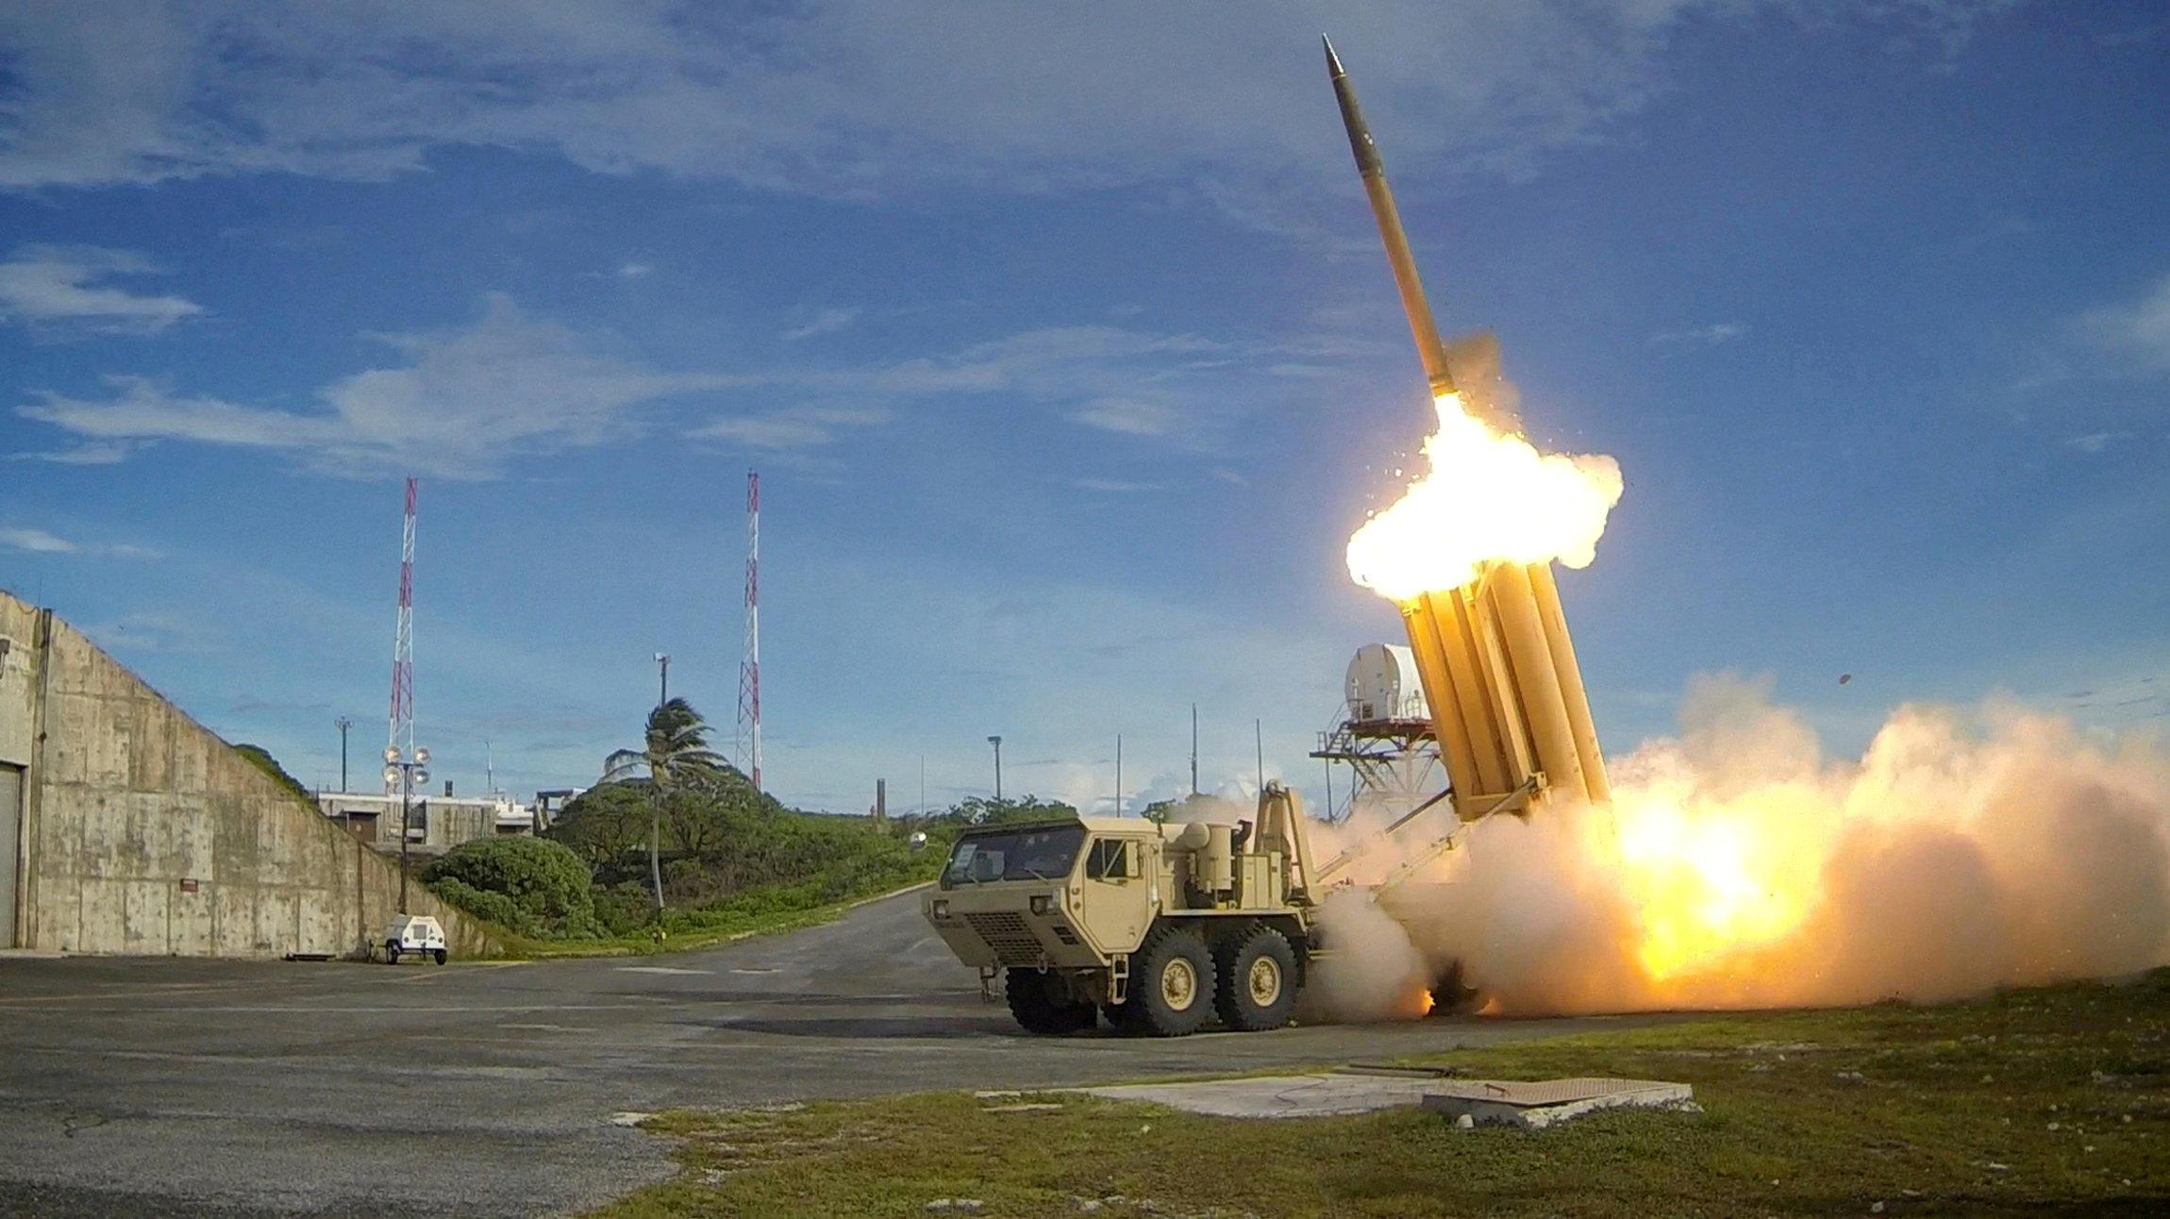
Concerns about Growing Chinese Leverage over Korea
Terminal High Altitude Area Defense (THAAD)

Slide 17
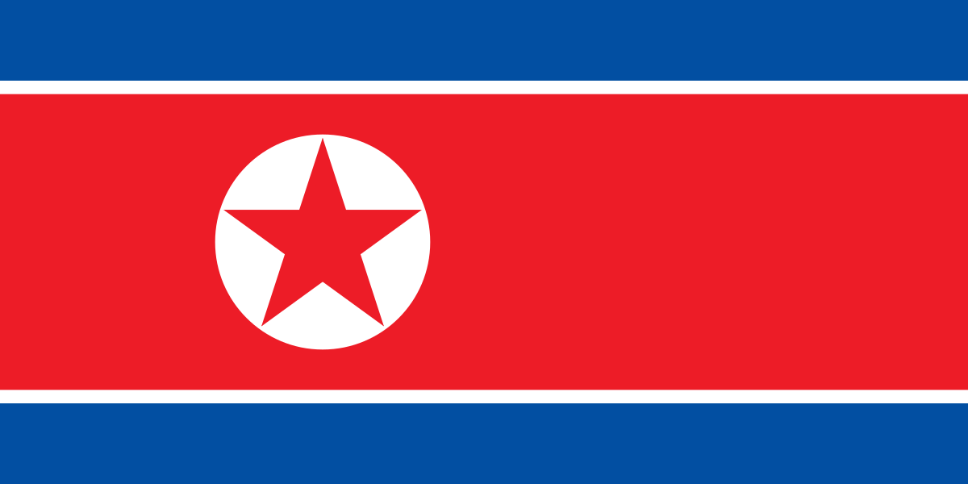
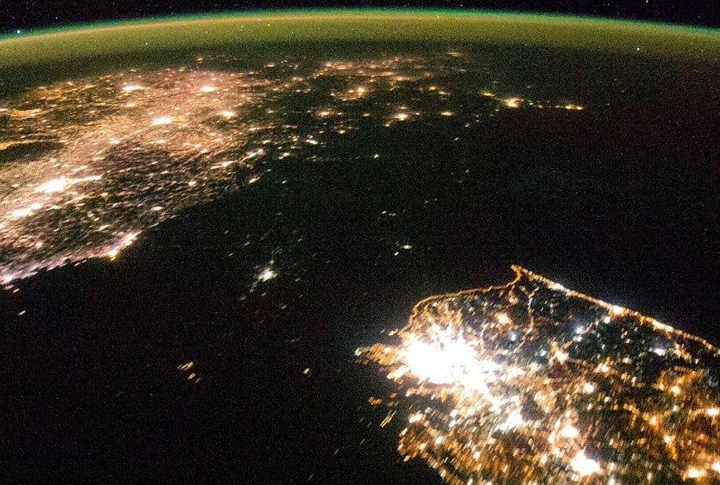
The North Korea Question
Arguably, the pivotal factor affecting Korea and Belt & Road
Decrepit state of DPRK infrastructure
Uncertainties in Inter-Korean relations
Contrasting ROK-PRC long-term visions for the Korean Peninsula

Slide 18
THANK YOU!
Alan Ahn
Director of Programs and Communications, GABI
E-mail: alanahn@thegabi.com
Office: 202-499-7978

